Slide 1

Bin Picking Studio 1.12
Introduction and Training
Covers Bin Picking Studio 1.12 and Locator Studio 1.5. Based on the VGR documentation.
Notes:
This deck follows the VGR 1.12 documentation. Each slide's notes name the docs page it comes from.

Slide 2
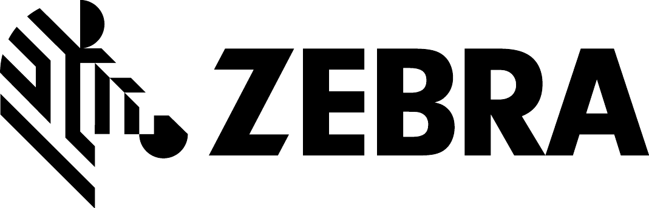
Training agenda
01
Getting started
06
Calibration
BPS and LS, solution types, vision controller, users, network
Types, procedure, verification
02
Studio interface
07
Environment
Solutions, PhoXi page, software modules
Scene, virtual robot, joint limits, scene states
03
Robot communication
08
Settings
Robot module, channels, the picking cycle
How settings work and the most important ones
04
BPS solution setup
09
Deployment and troubleshooting
Robot, gripper, picked object, gripping points, grasping methods
Deployment page, object status, Inspector, support
05
Vision system and localization
10
Locator Studio specifics
Sensors, scanning profiles, CAD / AI / Layer engines
LS setup and the reported pose
Bin Picking Studio 1.12 · Training
2
Notes:
Suggested order for a one-day training. Bring the customer's objects and gripper model for the practical part.

Slide 3
01
IN THIS CHAPTER
Bin Picking Studio and Locator Studio
The five solution types
Getting started
The vision controller
First start-up and user roles
Network setup
Remote access
Autostart

Slide 4
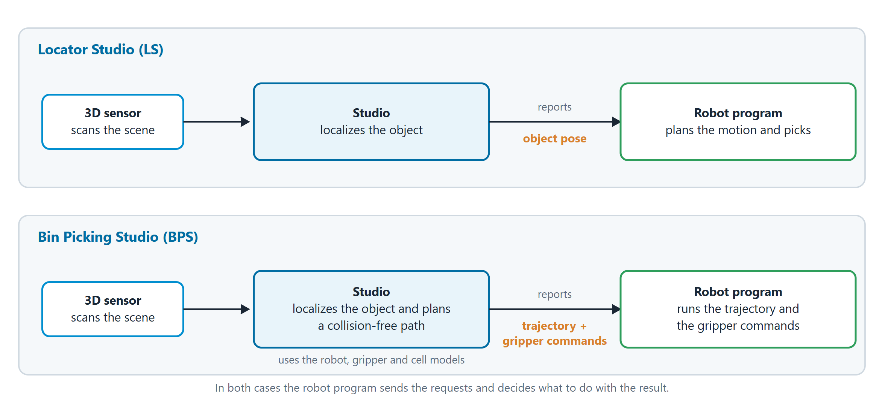
GETTING STARTED
One Studio, two products
Locator Studio (LS) reports the pose of the localized object. The robot program plans the motion itself.
Bin Picking Studio (BPS) reports a collision-free trajectory and the gripper commands. To plan the path it needs models of the robot, the gripper and the cell.
In both cases the Studio never takes control of the robot. It only answers the action requests that the robot program sends.
The solution type you choose decides whether a solution is BPS or LS.
Bin Picking Studio 1.12 · Training
4
Notes:
Source in the docs: Getting Started > Solution types.

Slide 5
GETTING STARTED
The five solution types
You choose the type in the Create a new solution dialog.
Solution type | Product | Recognition by | Reports | Ideal for
CAD Localization | LS | CAD model | Object pose | Picking from belt, assembly task
AI Localization | LS | AI | Object pose | Simple depalletization
Layer Localization | LS | Top layer | Top-layer pose | Picking whole layers
CAD Picking | BPS | CAD model | Collision-free trajectory | Bin picking
AI Picking | BPS | AI | Collision-free trajectory | Complex depalletization
Tip: Which types you can create depends on the software modules (licenses) of the installation. Without a license the Create button is disabled.
Bin Picking Studio 1.12 · Training
5
Notes:
Source in the docs: Solution types, Software modules.

Slide 6
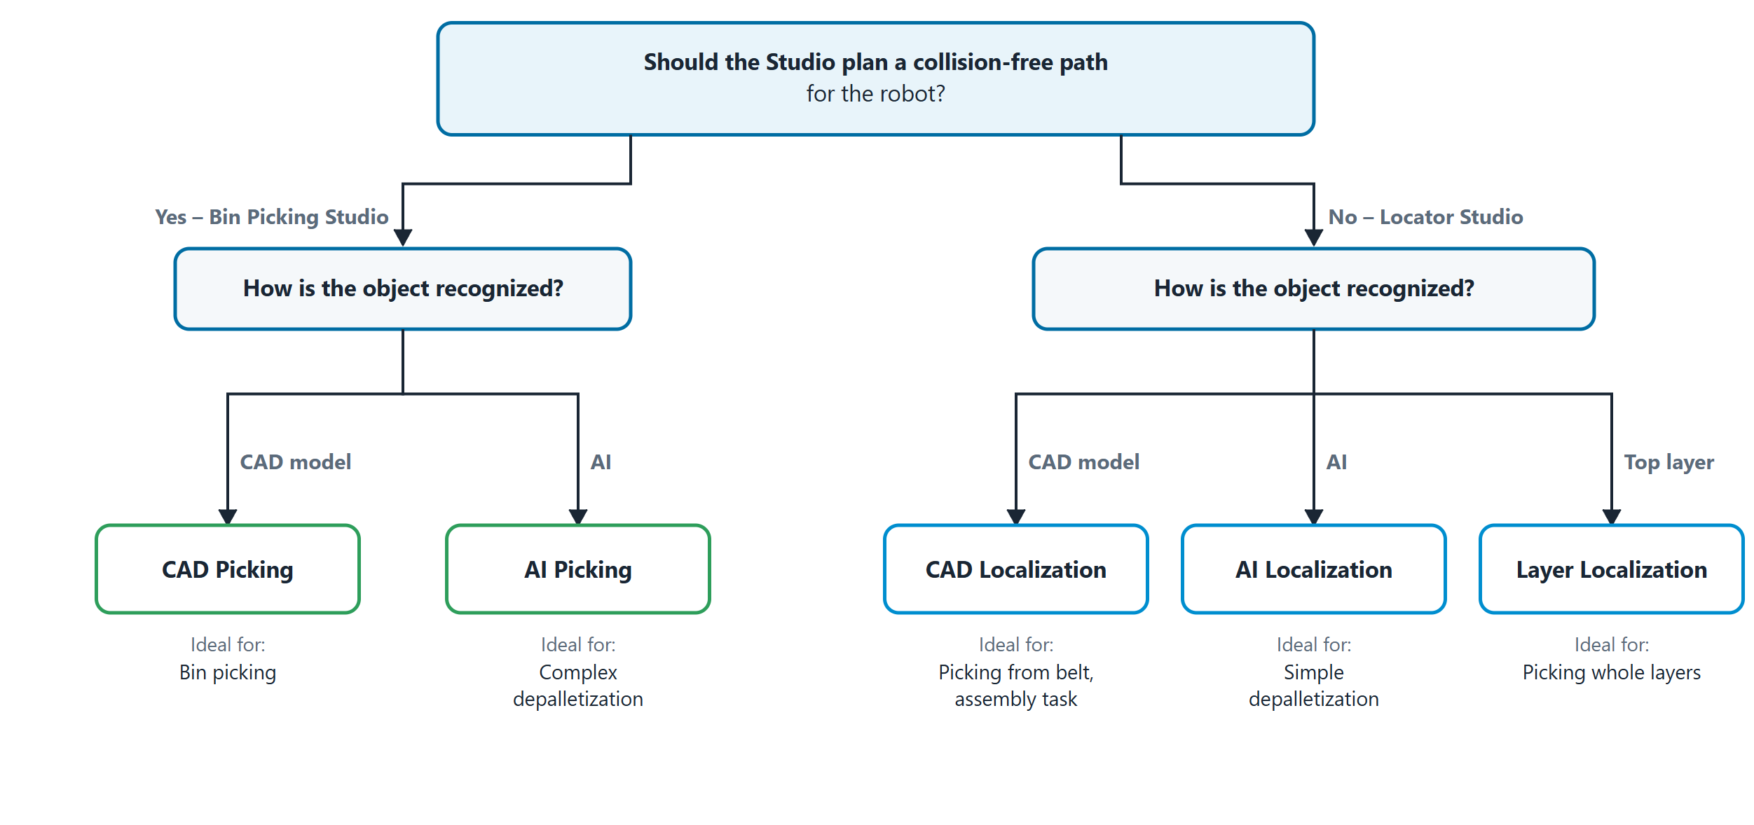
GETTING STARTED
Which type to choose
Should the Studio plan a collision-free path for the robot? Yes: a BPS type (CAD Picking, AI Picking). No: an LS type.
How should the object be recognized? By its CAD model, by AI, or as a whole top layer (Layer Localization, LS only).
Bin Picking Studio 1.12 · Training
6
Notes:
Source in the docs: Solution types > Which type to choose.

Slide 7
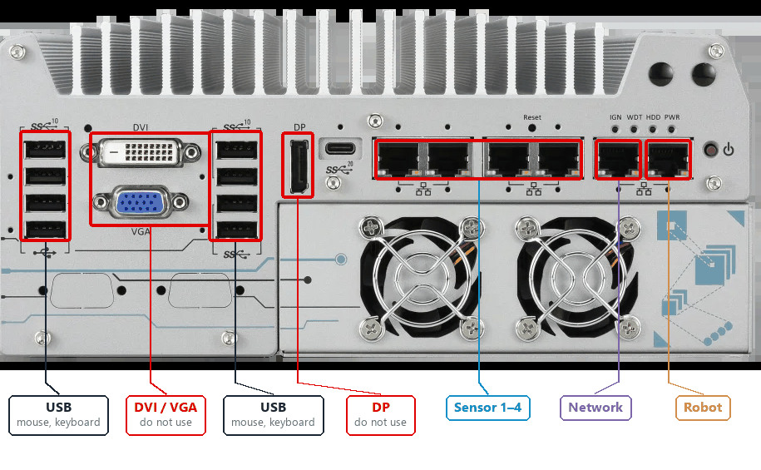
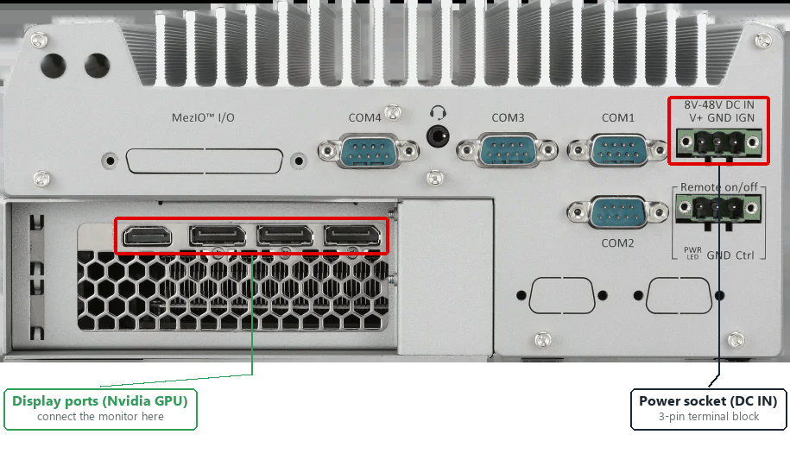
GETTING STARTED
The vision controller
An industrial computer with Ubuntu 22.04 and the Studio pre-installed.
Front: Ethernet and USB ports
Back: Nvidia GPU display ports and DC IN
Six Ethernet ports, left to right: Sensor 1–4, Network, Robot.
The DVI, VGA and DP ports of the integrated graphics are not supported.
Connect the monitor to the Nvidia GPU ports on the back. No monitor: use the HDMI dummy plug.
Ambient temperature at most 50 °C. On a wall, keep the heatsink fins vertical.
Bin Picking Studio 1.12 · Training
7
Notes:
Source in the docs: Initial setup > Vision controller overview, Mounting.

Slide 8
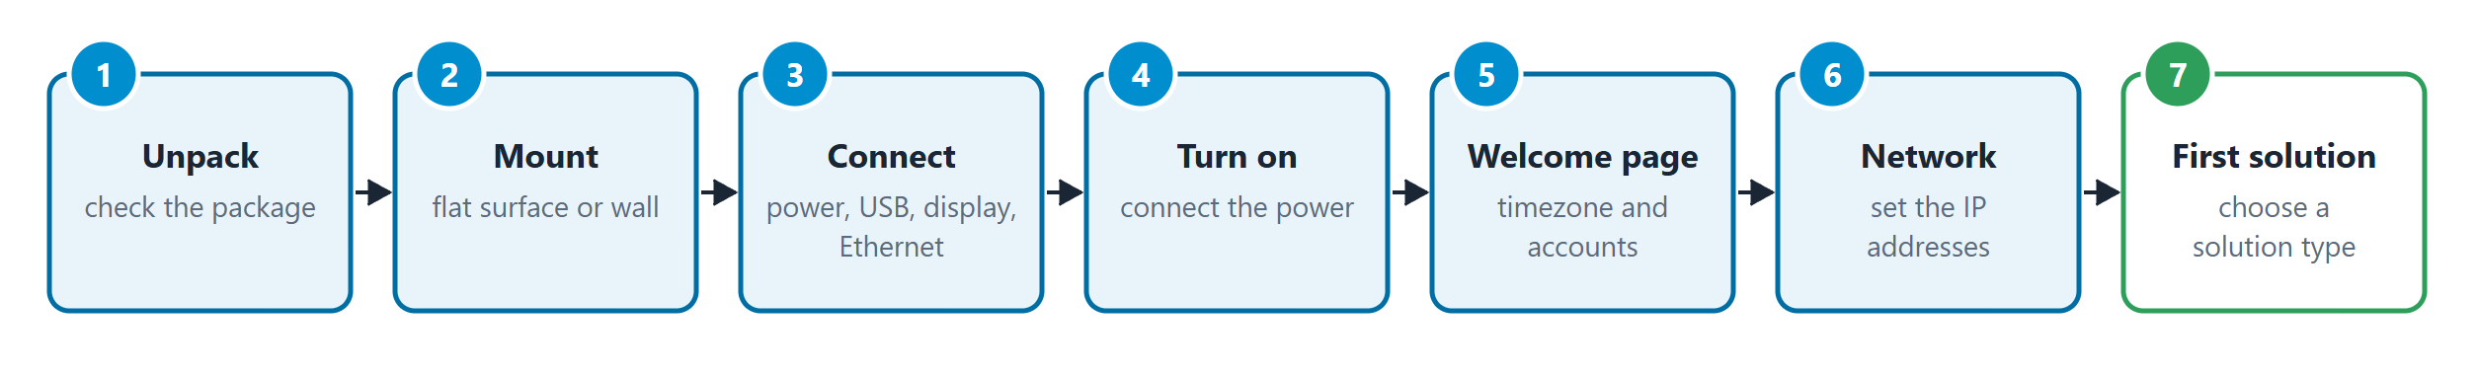
GETTING STARTED
First start-up
The Welcome page guides you through the first setup
Timezone: click your location on the map. You can change it later on the Customization page.
Master account: the Customer Admin account that manages the Studio and the employee accounts.
Employee accounts (optional): accounts with the Maintenance or Operator role. You can add them later.
Then continue with the network setup and your first solution.
Bin Picking Studio 1.12 · Training
8
Notes:
Source in the docs: Initial setup > Welcome page.

Slide 9
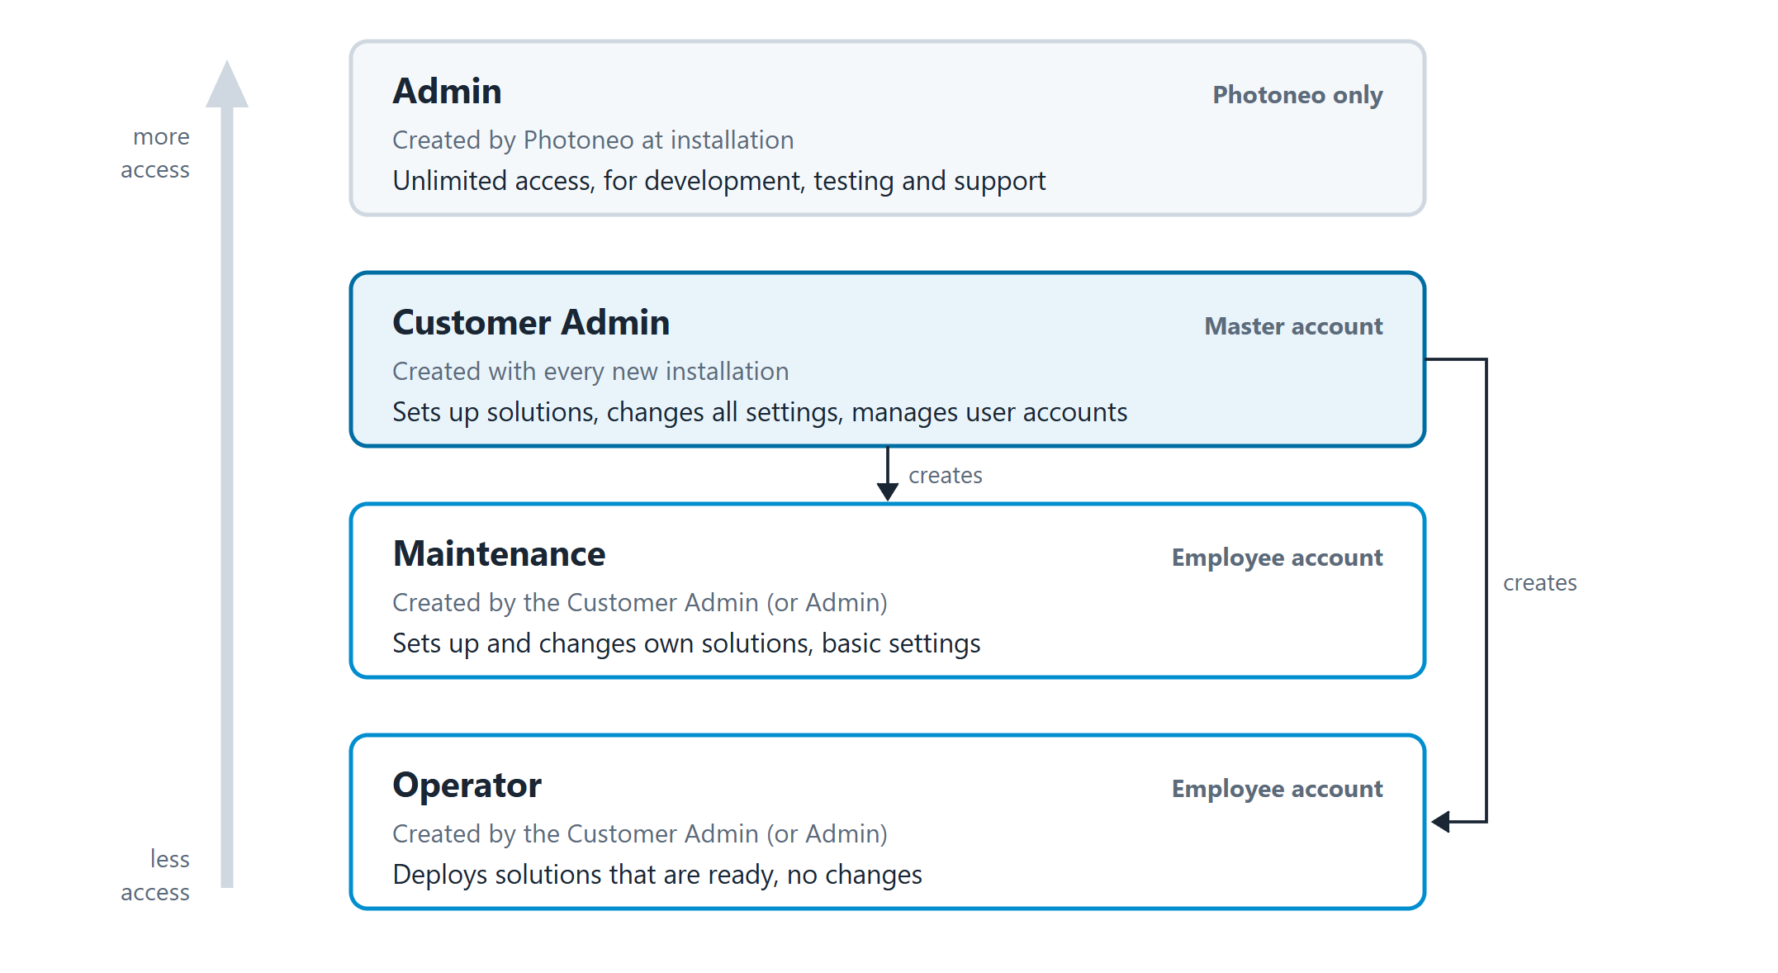
GETTING STARTED
User roles
Admin: Photoneo employees only, for development and support.
Customer Admin: the Master account. Sets up solutions, changes the network and manages the user accounts.
Maintenance: creates and changes its own solutions and uses the PhoXi page. No user management, no network settings.
Operator: deploys solutions marked ready. Cannot change solutions, grippers or settings.
Accounts are created in the menu > Account management > Create account.
Bin Picking Studio 1.12 · Training
9
Notes:
Source in the docs: Users and Permissions.

Slide 10
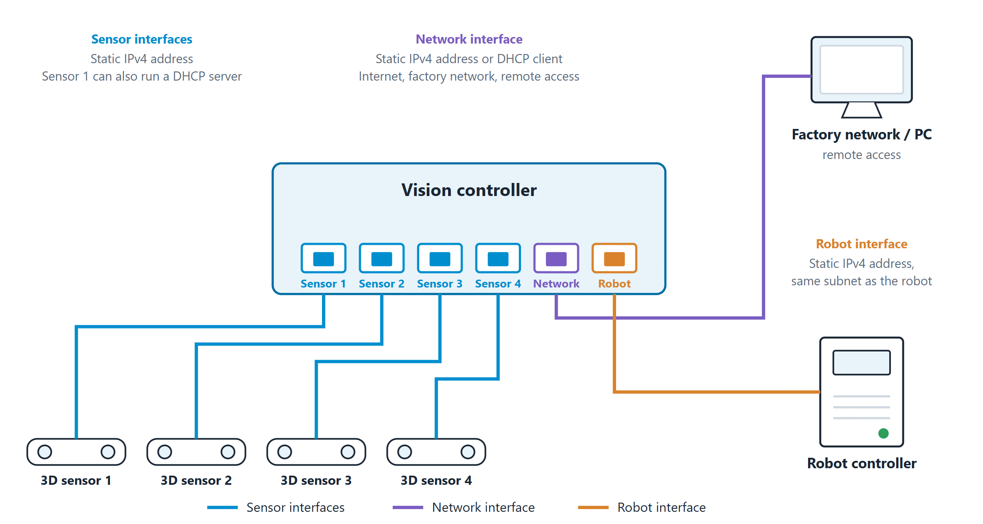
GETTING STARTED
Network: three kinds of interfaces
Interface | Ports | Connect | IP address
Sensor interfaces | Sensor 1–4 | Photoneo 3D sensors, directly or through a Gigabit switch | Static. Interface 1 can run a DHCP server
Network interface | Network | Factory network, Internet, a computer for remote access | Static or DHCP
Robot interface | Robot | The robot controller, directly | Static, same subnet as the robot
Set all interfaces on the Network page of the Studio, never in the Ubuntu network panel.
Robot interface defaults: vision controller 192.168.1.1, robot controller 192.168.1.2. Use Test connection after saving.
Subnets must not overlap each other or the reserved ranges 169.254.0.0/16, 172.18.0.0/28 and 192.168.101.0/24.
Bin Picking Studio 1.12 · Training
10
Notes:
Source in the docs: Network setup > Overview, Configuring the interfaces, Reserved IP ranges.

Slide 11
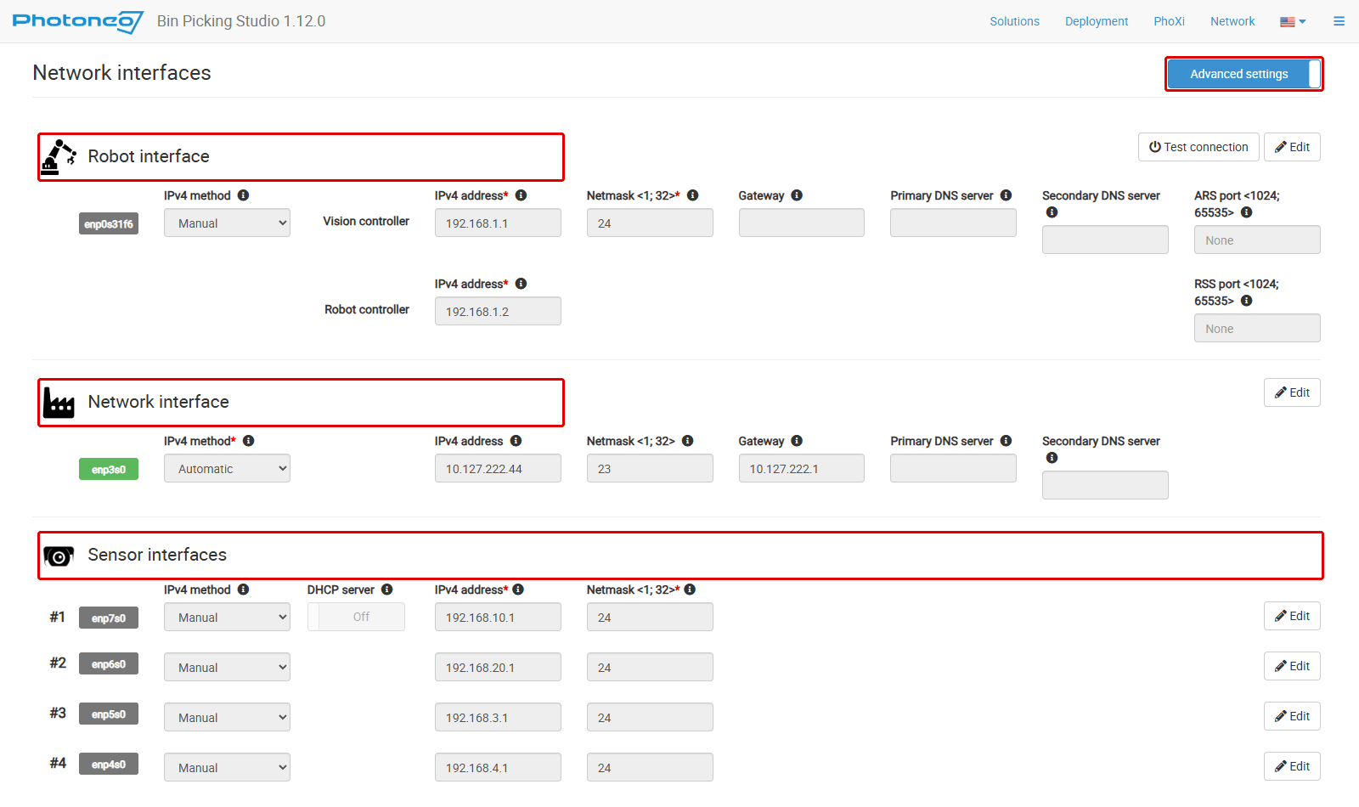
GETTING STARTED
The Network page
One block per interface: Robot interface, Network interface, Sensor interfaces.
Click Edit, change the values, then Save or Discard. Other blocks are locked meanwhile.
Advanced settings shows the gateway, the DNS servers and the ARS / RSS ports.
Leave the ARS and RSS ports empty unless a Photoneo technician advises otherwise. A custom port must be set in the Robot module too.
Bin Picking Studio 1.12 · Training
11
Notes:
Source in the docs: Network setup > Configuring the interfaces.

Slide 12
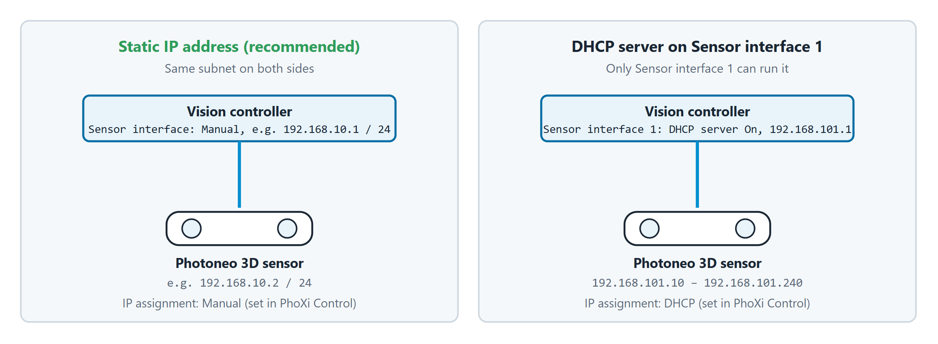
GETTING STARTED
Sensor IP addresses
A sensor prefers its fixed IPv6 link-local address and falls back to IPv4, so always give it a valid IPv4 address.
Recommended: a static address on the sensor interface and on the sensor (PhoXi Control), on the same subnet.
Or: turn on the DHCP server of Sensor interface 1. It then uses 192.168.101.1 and gives sensors .10–.240.
In PhoXi Control, N/A in the IPv4 field means the configuration is invalid.
Tip: More than four sensors? Connect a Gigabit switch to any sensor port.
Bin Picking Studio 1.12 · Training
12
Notes:
Source in the docs: Network setup > Sensor interfaces, Sensor connection.

Slide 13
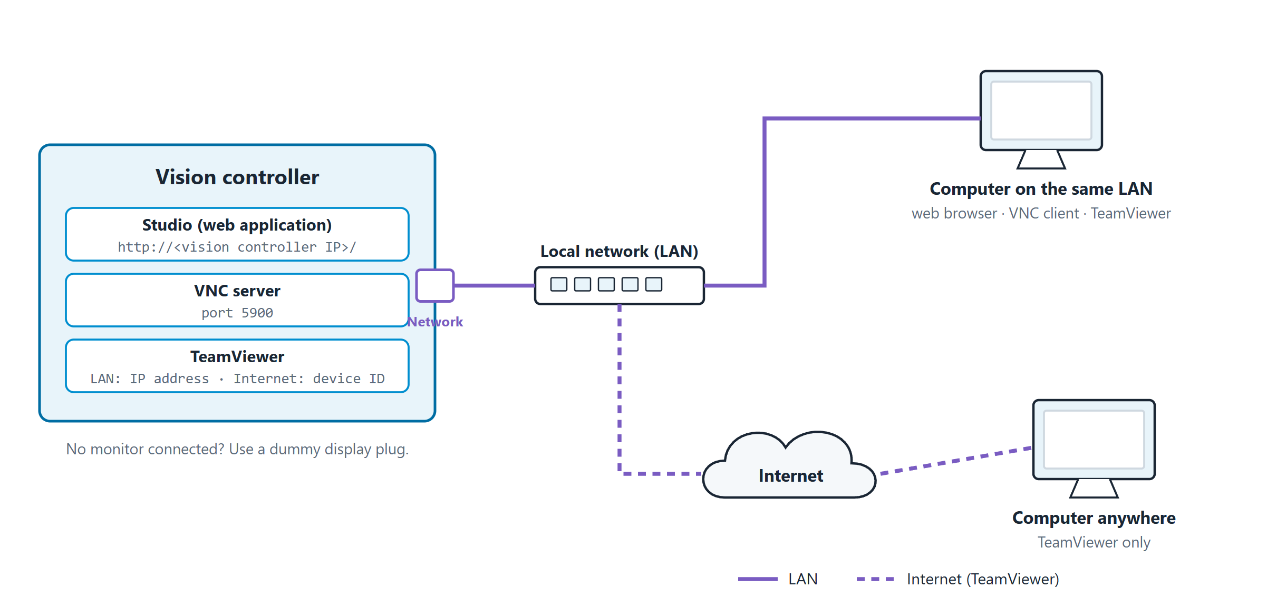
GETTING STARTED
Remote access
 | Web browser | VNC | TeamViewer
You see | The Studio only | The whole desktop | The whole desktop
PhoXi Control | No | Yes | Yes
Network | Local network | Local network | Local network or Internet
Connect with | IP address | IP address, port 5900 | IP address or device ID
Password | Studio account | From Photoneo support | Shown in TeamViewer
Connect through the port labelled Network. A static IP address is recommended for VNC and TeamViewer.
No monitor on the vision controller? Plug in the dummy display plug.
Browser: Google Chrome is recommended.
Bin Picking Studio 1.12 · Training
13
Notes:
Source in the docs: Remote access.

Slide 14
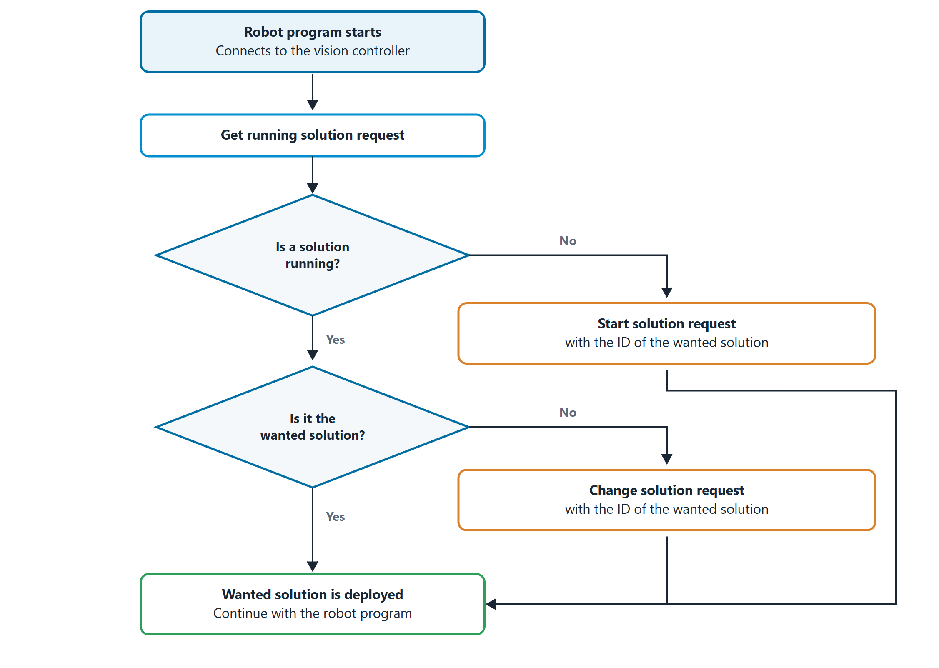
GETTING STARTED
Autostart
There is no autostart setting. After a restart the Studio restores its last state: a deployed solution is deployed again.
The robot program decides which solution runs:
Get running solution: which solution is deployed?
Start solution: deploy one when none is running.
Change solution: replace the running one.
The solution must be marked ready and its robot brand must match the robot that sends the request.
Bin Picking Studio 1.12 · Training
14
Notes:
Source in the docs: Autostart.

Slide 15
02
IN THIS CHAPTER
Navigation bar and menu
Solutions page
Studio interface
Creating a solution
The solution page and setup steps
PhoXi page
Software modules and Customization

Slide 16
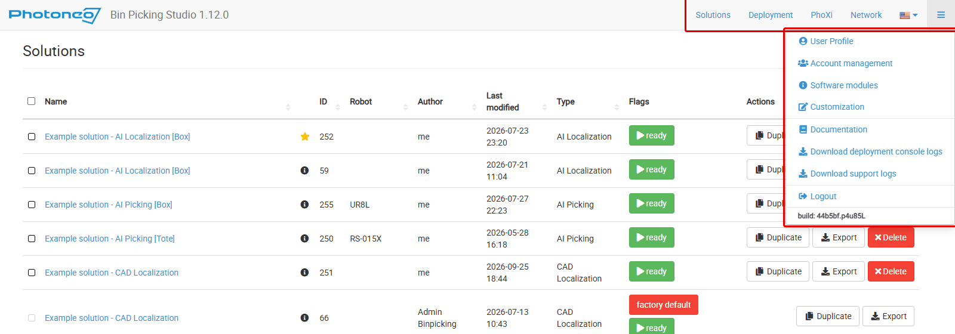
STUDIO INTERFACE
Navigation bar and menu
Top bar: Solutions, Deployment, PhoXi, Network and a language selector.
Menu: User Profile, Account management, Software modules, Customization, Documentation, Download deployment console logs, Download support logs, Logout.
The menu also shows the build number of the Studio.
Bin Picking Studio 1.12 · Training
16
Notes:
Source in the docs: Studio Interface.

Slide 17
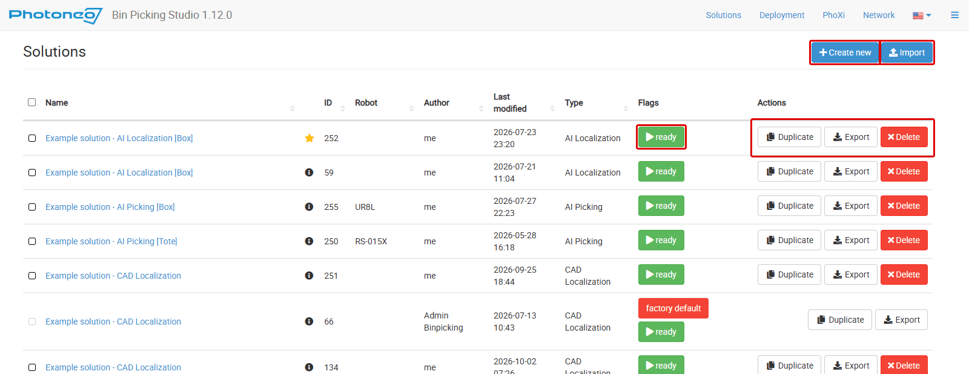
STUDIO INTERFACE
Solutions page
ready: can be deployed. Click the flag to deploy.
last run: deployed last.
factory default: preloaded, cannot be edited or deleted. Duplicate it first.
Duplicate, Export and Delete in each row.
Solutions are exported and imported as .pbcf files, with their attachments.
Example solutions: CAD Picking, AI Localization [Box], Layer Localization and more.
Bin Picking Studio 1.12 · Training
17
Notes:
Source in the docs: Solutions page.

Slide 18
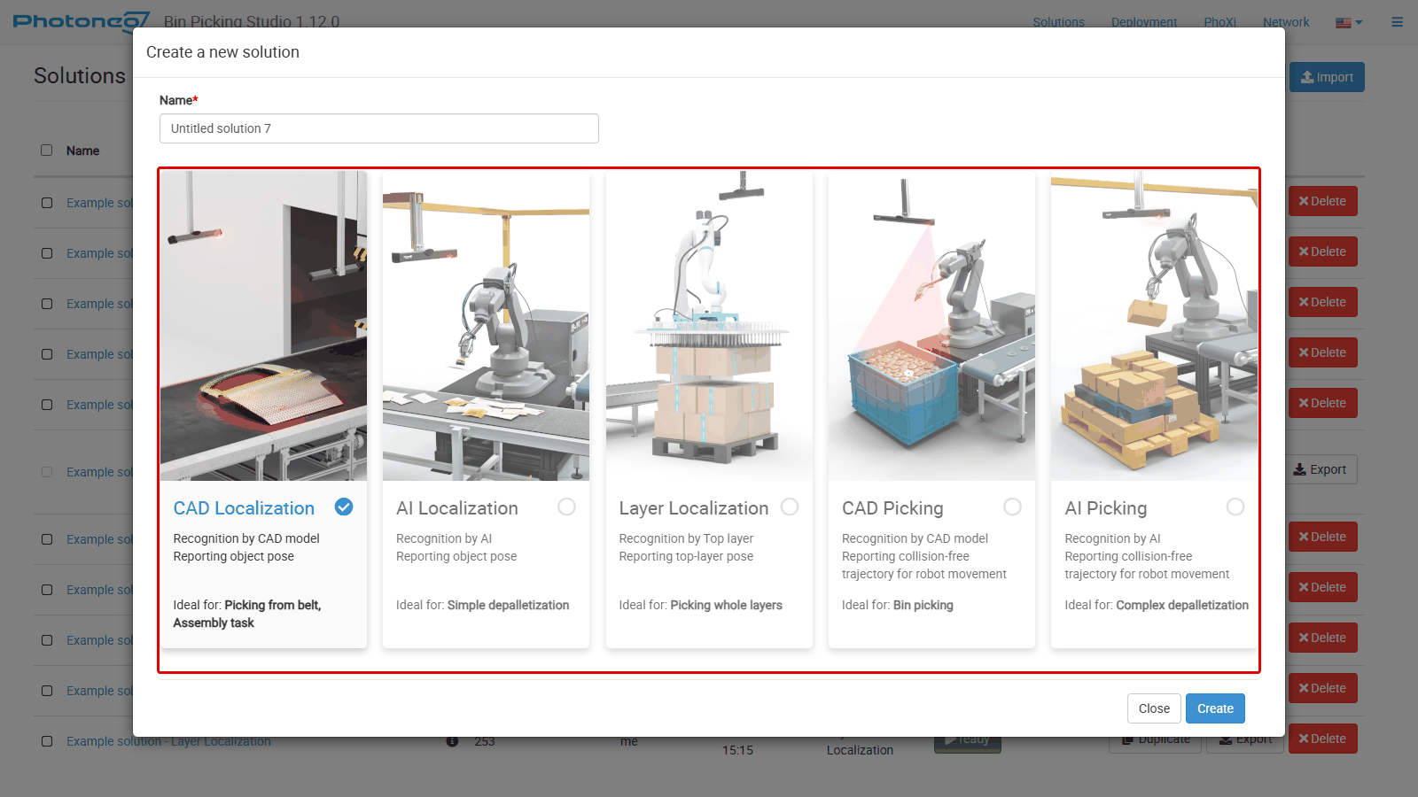
STUDIO INTERFACE
Creating a solution
Click Create new on the Solutions page.
Enter the Name.
Choose the solution type.
Click Create.
No license for the type? The dialog says "No valid license found for this solution type". Check the Software modules page.
To start faster, Duplicate an example solution, for example "Example solution - CAD Picking".
Bin Picking Studio 1.12 · Training
18
Notes:
Source in the docs: Solutions page > Creating a solution, Solution types.

Slide 19
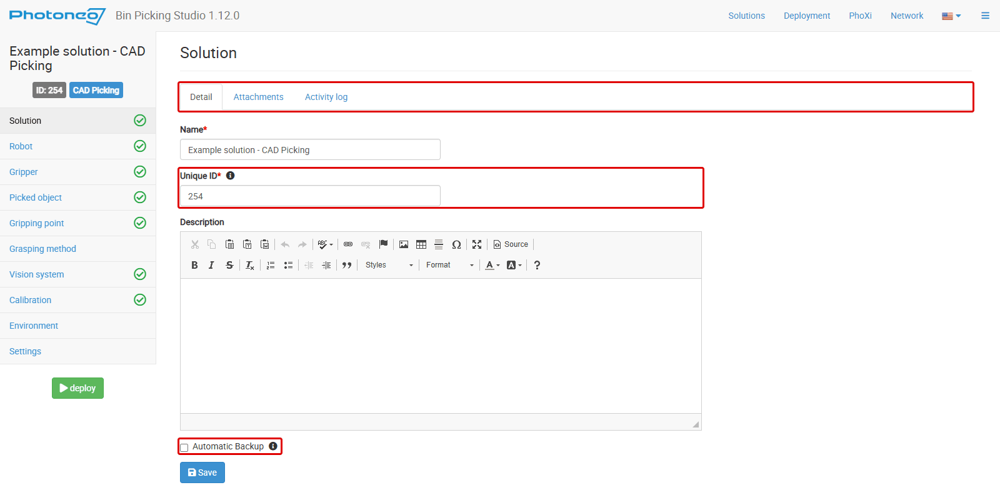
STUDIO INTERFACE
The solution page
Detail: name, Unique ID (used in the robot's requests), description and Automatic Backup.
Automatic Backup exports the solution on deployment after a change, to ~/Desktop/Backup. It keeps 3 exports per solution and the 3 last deployed solutions.
Attachments: robot program backups and other files. Up to 20 files, 15 MB each, 100 MB in total.
Activity log: who changed what. Filter it and export it to CSV.
Bin Picking Studio 1.12 · Training
19
Notes:
Source in the docs: Solutions page > Solution detail page.

Slide 20
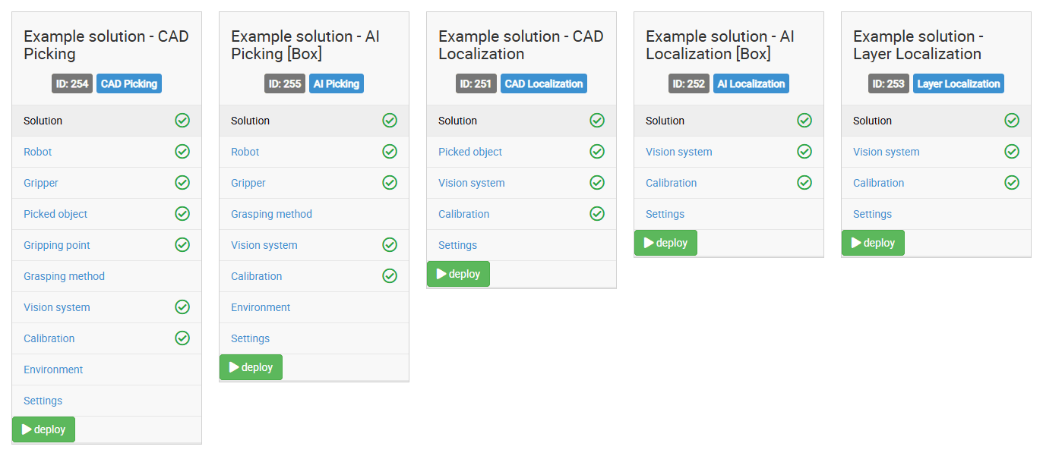
STUDIO INTERFACE
Setup steps depend on the solution type
The solution menu shows only the steps the type needs, in this order. Completed steps get a green check.
BPS types add Robot, Gripper, Grasping method and Environment. CAD types add Picked object; CAD Picking also Gripping point.
When all required steps are done, the deploy button appears.
Bin Picking Studio 1.12 · Training
20
Notes:
Source in the docs: Solution types > Setup steps of each solution type.

Slide 21
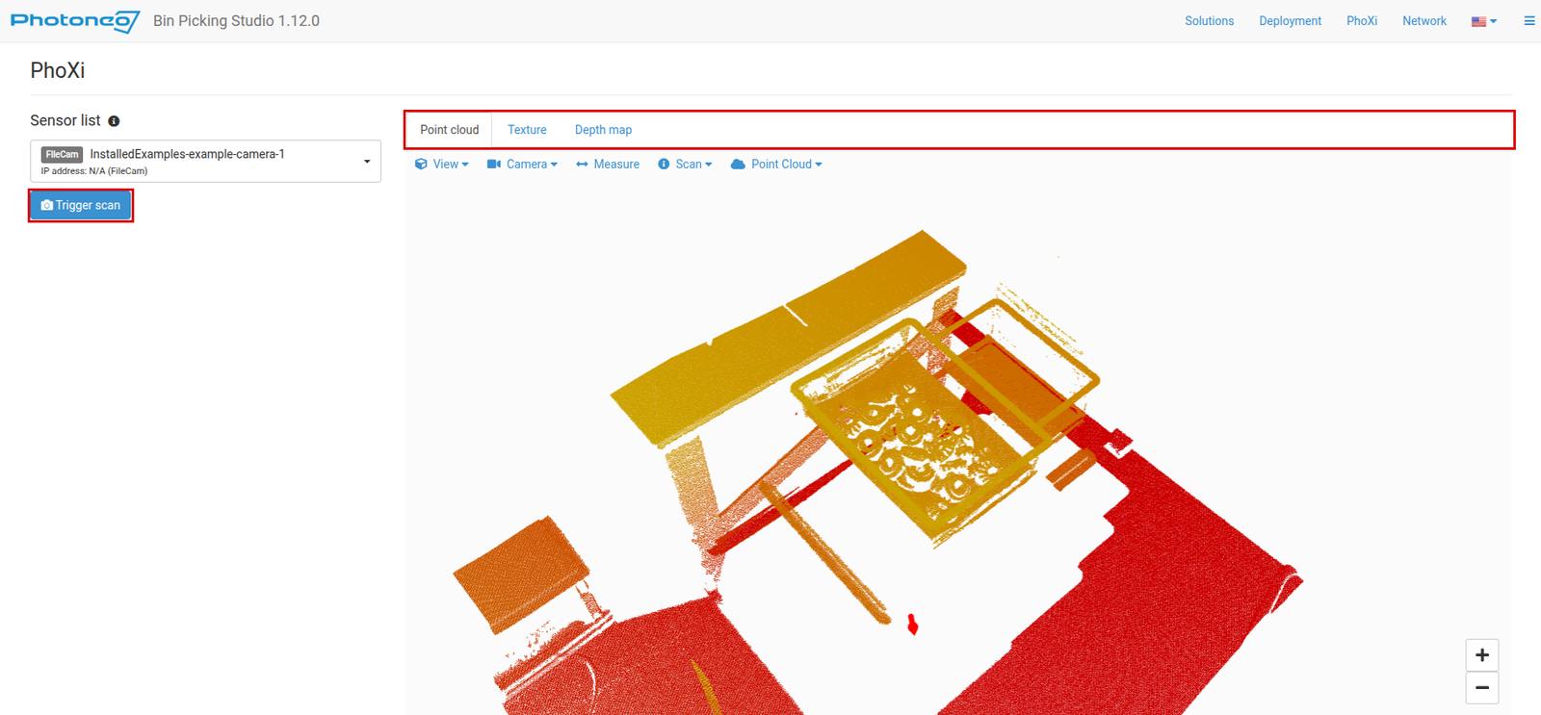
STUDIO INTERFACE
PhoXi page
Select a sensor in the Sensor list (PhoXi, MCC, size S/M/L/XL, status).
Click Connect.
Click Trigger scan.
Check the Point cloud, Texture and Depth map tabs.
Use it to check what the sensor sees. Full sensor configuration is done in PhoXi Control (over VNC or TeamViewer).
A sensor connected here is also connected on the Environment page.
Bin Picking Studio 1.12 · Training
21
Notes:
Source in the docs: PhoXi page.

Slide 22
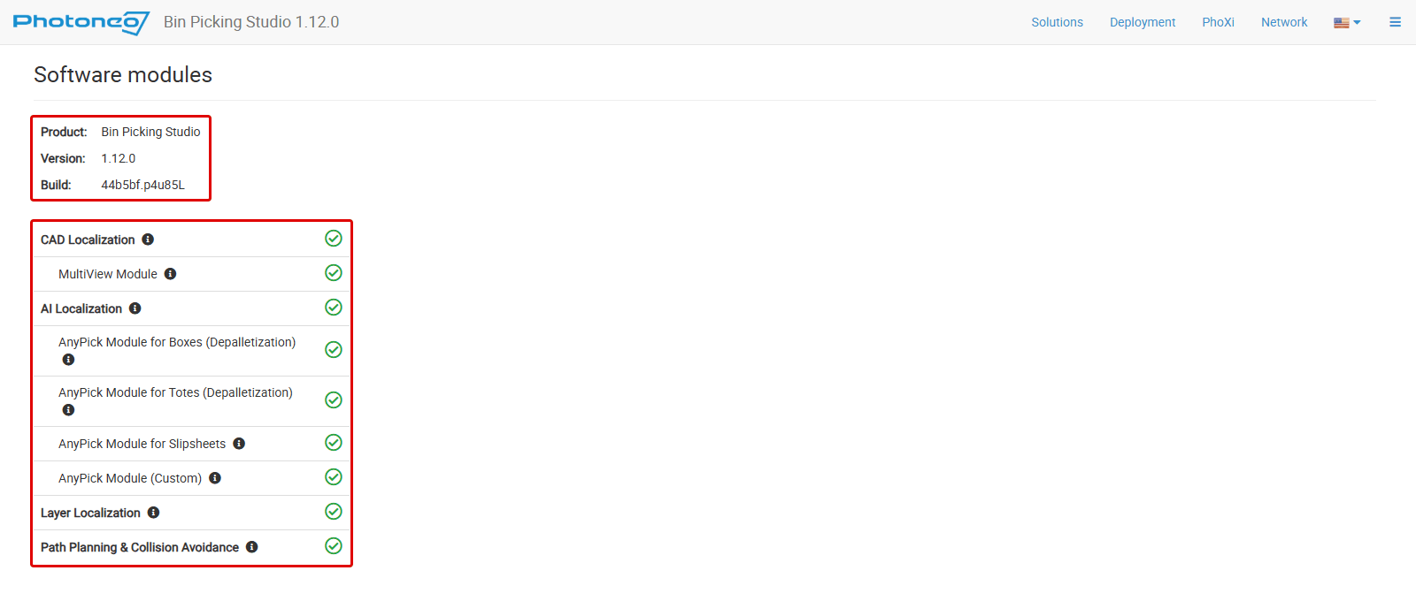
STUDIO INTERFACE
Software modules and Customization
Software modules
Product, version and build of the Studio.
Engines: CAD Localization (+ MultiView), AI Localization (+ AnyPick modules for boxes, totes, slipsheets, custom), Layer Localization, Path Planning & Collision Avoidance.
To unlock a module, contact your sales representative.
Customization
Primary color, logo, login page text, error page text and timezone.
Bin Picking Studio 1.12 · Training
22
Notes:
Source in the docs: Software modules, Customization.

Slide 23
03
IN THIS CHAPTER
Robot module
The two communication channels
Robot communication
A bin picking cycle
Other action requests

Slide 24
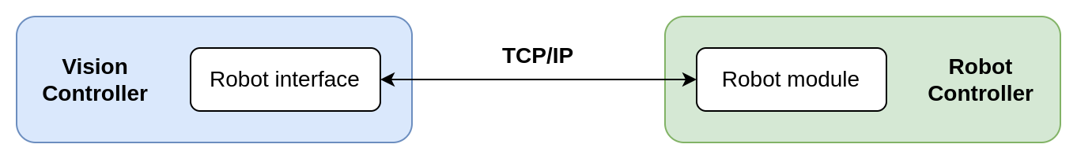
ROBOT COMMUNICATION
Robot module
The Robot module is installed on the robot controller. There is one for each robot brand.
It extends the robot's library with the Photoneo robotic API: a set of jobs or routines the robot programmer calls.
Communication is TCP/IP only. Check the Prerequisites in the integration guide of your brand.
The Studio never moves the robot. The robot programmer implements the gripper commands and sets speed, acceleration and accuracy.
Extreme caution during commissioning: set safe speeds and be ready to stop the robot.
Bin Picking Studio 1.12 · Training
24
Notes:
Source in the docs: Robot communication overview, BPS Robot integration guides.

Slide 25
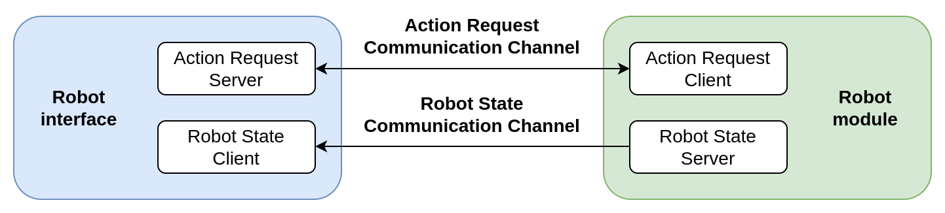
ROBOT COMMUNICATION
Two communication channels
Action Request channel
Server on the vision controller (ARS), client in the robot program.
The robot sends action requests; the Studio answers.
Robot State channel (BPS)
Server on the robot (Robot State Server), client on the vision controller.
Sends joint positions and the TCP pose. Used for teaching gripping points, calibration, hand-eye vision systems and the live robot view.
Needed by BPS, optional for LS.
Bin Picking Studio 1.12 · Training
25
Notes:
Source in the docs: Robot communication overview > Communication channels, Network setup > Robot interface.

Slide 26
ROBOT COMMUNICATION
A bin picking cycle
The basic action requests of a BPS robot program.
Initialization
Start and End joint poses for a vision system
Scan
+ Wait for scan completion
Trajectory
+ Receive trajectory
Bin picking routine
Robot runs the trajectory, Attach / Detach
Place
Your code, then the next Scan
Send Scan as soon as the robot has cleared the scanning area. The Studio localizes and plans while the robot places the part.
Send Trajectory just before the pick, so the Studio has the most candidates to choose from.
Always scan again before the next Trajectory request. Objects may have moved during the last pick.
If the cell can detect a failed pick, send Pick-failed. The object is then tried later.
Most requests need the vision system ID.
Bin Picking Studio 1.12 · Training
26
Notes:
Source in the docs: Action requests > Bin picking action requests.

Slide 27
ROBOT COMMUNICATION
Other action requests
Request | What it does
Change scene state | Switches the active state of the cell model (see Environment)
Change localization bounding box | Activates another bounding box before the next Scan
Get vision system status | Reports the state of a vision system
Trigger scan / Localize on the last scan | MultiView scans; localize again without a new scan
Add calibration point, Start / Save / Stop automatic calibration | Calibration from the robot program
Get running / Start / Change / Stop solution | Choose and start the solution from the robot program
LS: Scan, Get objects | Locator Studio: scan, then get the object poses
Bin Picking Studio 1.12 · Training
27
Notes:
Source in the docs: Action requests. The DOC-11 update adds four more requests; see the Robot Module section of the docs.

Slide 28
04
IN THIS CHAPTER
Robot: model, mount orientation, base frame offset
Gripper and tool point
BPS solution setup
Picked object
Gripping points and invariances
Teaching a gripping point, oriented placing
Grasping methods

Slide 29
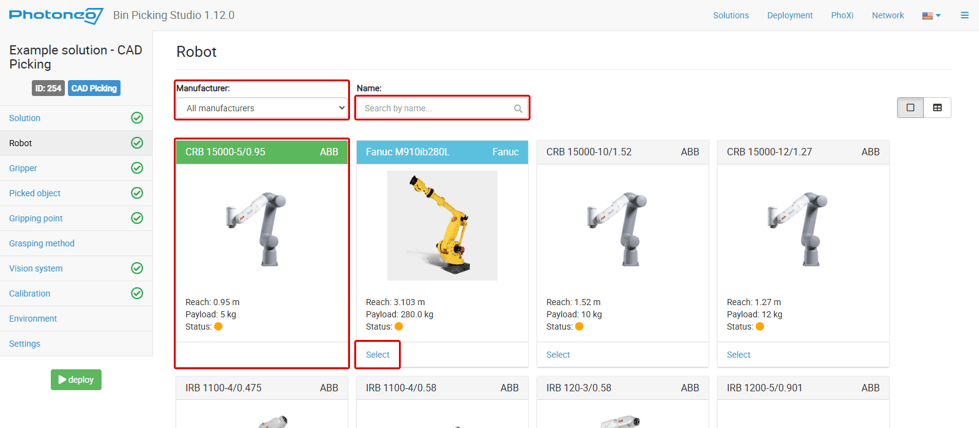
BPS SOLUTION SETUP
Robot step
Find the model with the Manufacturer and Name filters and click Select. Custom robots have a blue frame.
Changing the robot resets the joint limits, removes the calibration point datasets and turns off automatic calibration. Check the joint limits and calibrate again.
The Studio checks only the brand of the connected robot, not the model. Select the correct model.
Bin Picking Studio 1.12 · Training
29
Notes:
Source in the docs: Robot > Selecting a robot, Robot communication overview > Automatic brand recognition.

Slide 30
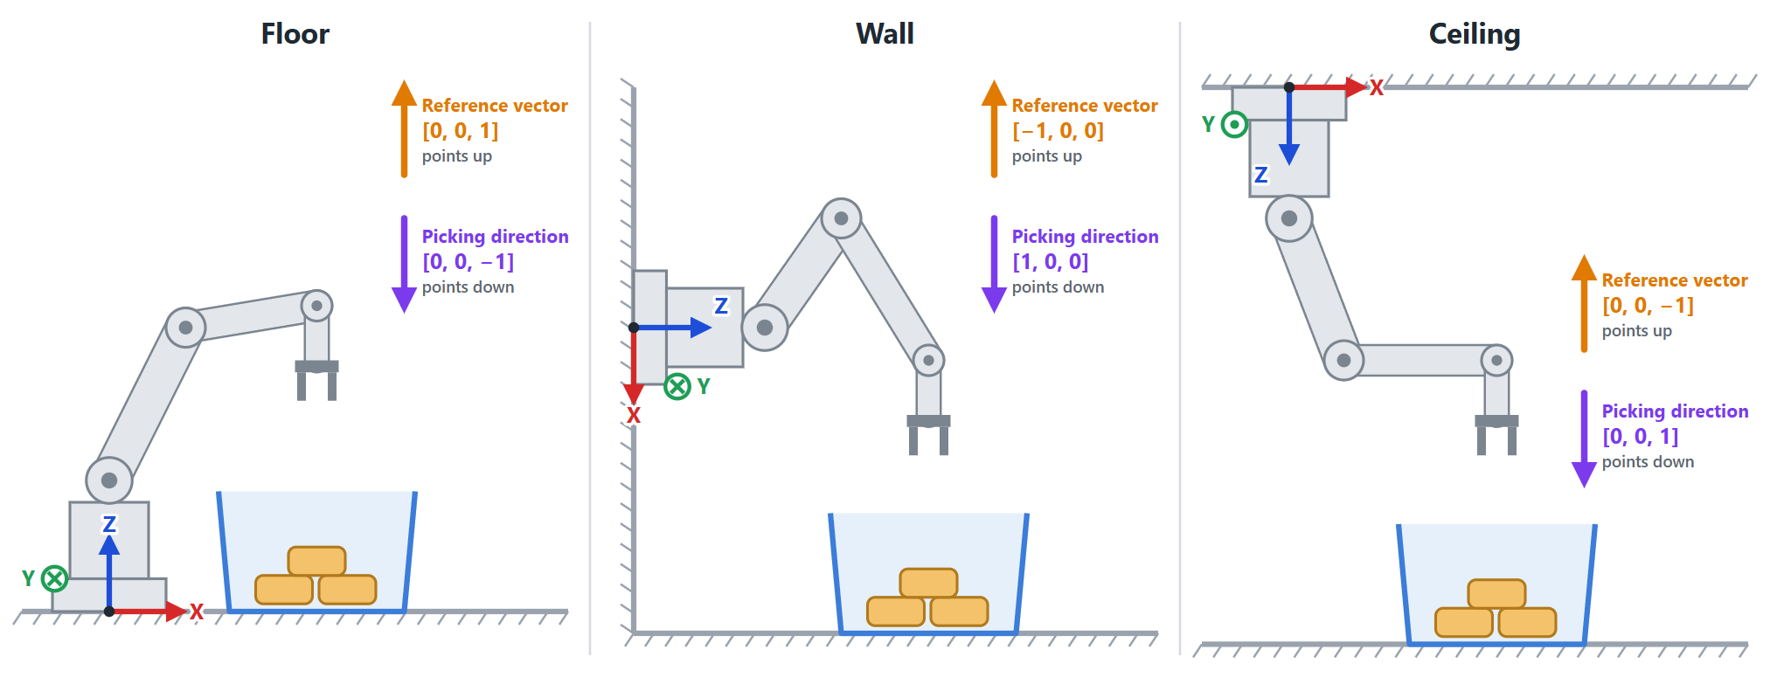
BPS SOLUTION SETUP
Robot mount orientation
Some settings are vectors in robot space. Change them for a wall or ceiling robot.
Setting | Floor | Wall | Ceiling
Gripper angle > Reference vector (points up) | 0, 0, 1 (default) | −1, 0, 0 | 0, 0, −1
Picking priority > Picking direction vector | 0, 0, −1 (default) | 1, 0, 0 | 0, 0, 1
Path stage 100 mm up, origin Robot | 0, 0, 100 | −100, 0, 0 | 0, 0, −100
Wall values depend on how the robot is turned. Kawasaki uses the Y-axis as the forward direction. Rotate the Environment scene to match the real cell.
Bin Picking Studio 1.12 · Training
30
Notes:
Source in the docs: Robot > Robot mount orientation.

Slide 31
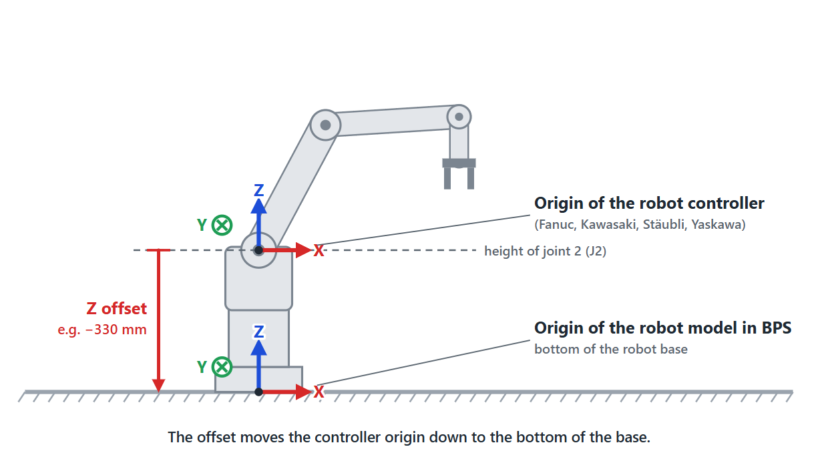
BPS SOLUTION SETUP
Base frame offsets
Fanuc, Kawasaki, Stäubli and Yaskawa
Brand | Where to set the Z offset
Fanuc | Menu > Setup > Frames > User Frame 1
Kawasaki | Aux Functions > Advanced Settings > Base Coordinates
Stäubli | Data > photoneo_common > frame > fBaseLink
Yaskawa | Robot > User Coordinate > USER COORDINATE 1
Note: The docs list the Z offset of every robot of these brands. Changing a base or user frame can move positions already taught in it.
The controller's origin is at the height of J2; the BPS robot model has it at the bottom of the base.
Without the Z offset, calibration fails. Set it once, before calibration.
Bin Picking Studio 1.12 · Training
31
Notes:
Source in the docs: Robot > Base frame offsets.

Slide 32
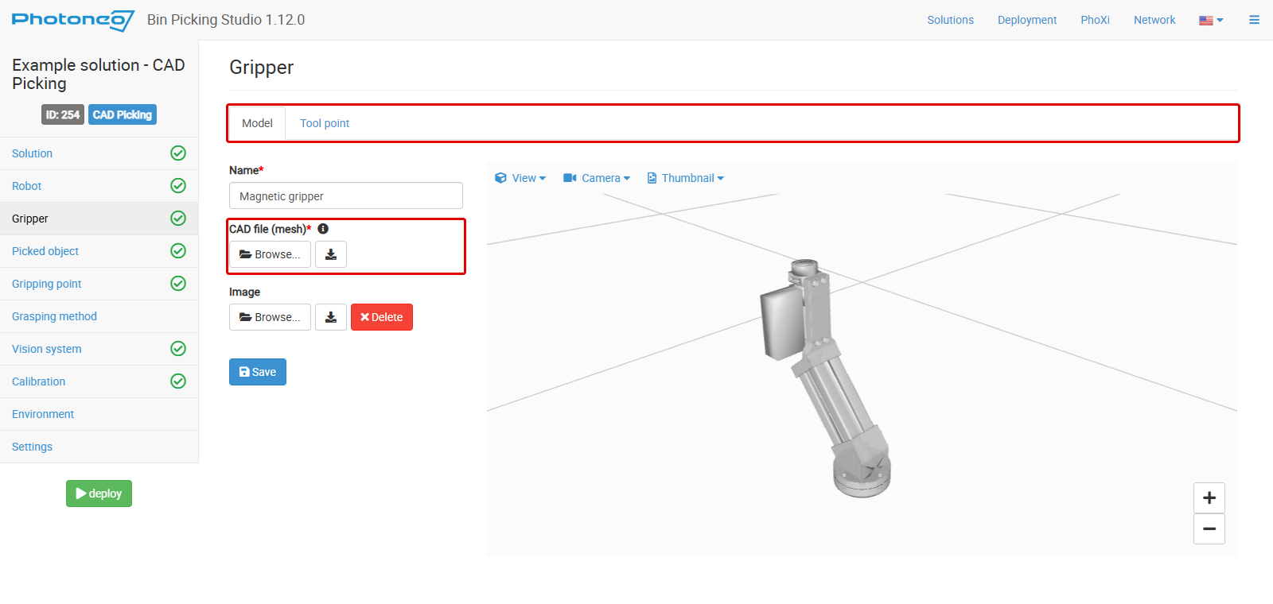
BPS SOLUTION SETUP
Gripper
Grippers are shared between solutions. Default grippers cannot be edited: duplicate them first.
CAD file (mesh): STL in millimeters. Include extra gear such as valves and split boxes, so path planning avoids them.
The origin of the model must be the mounting point on the robot flange.
Selecting another gripper removes the calibration point datasets. Calibrate again.
Bin Picking Studio 1.12 · Training
32
Notes:
Source in the docs: Gripper.

Slide 33
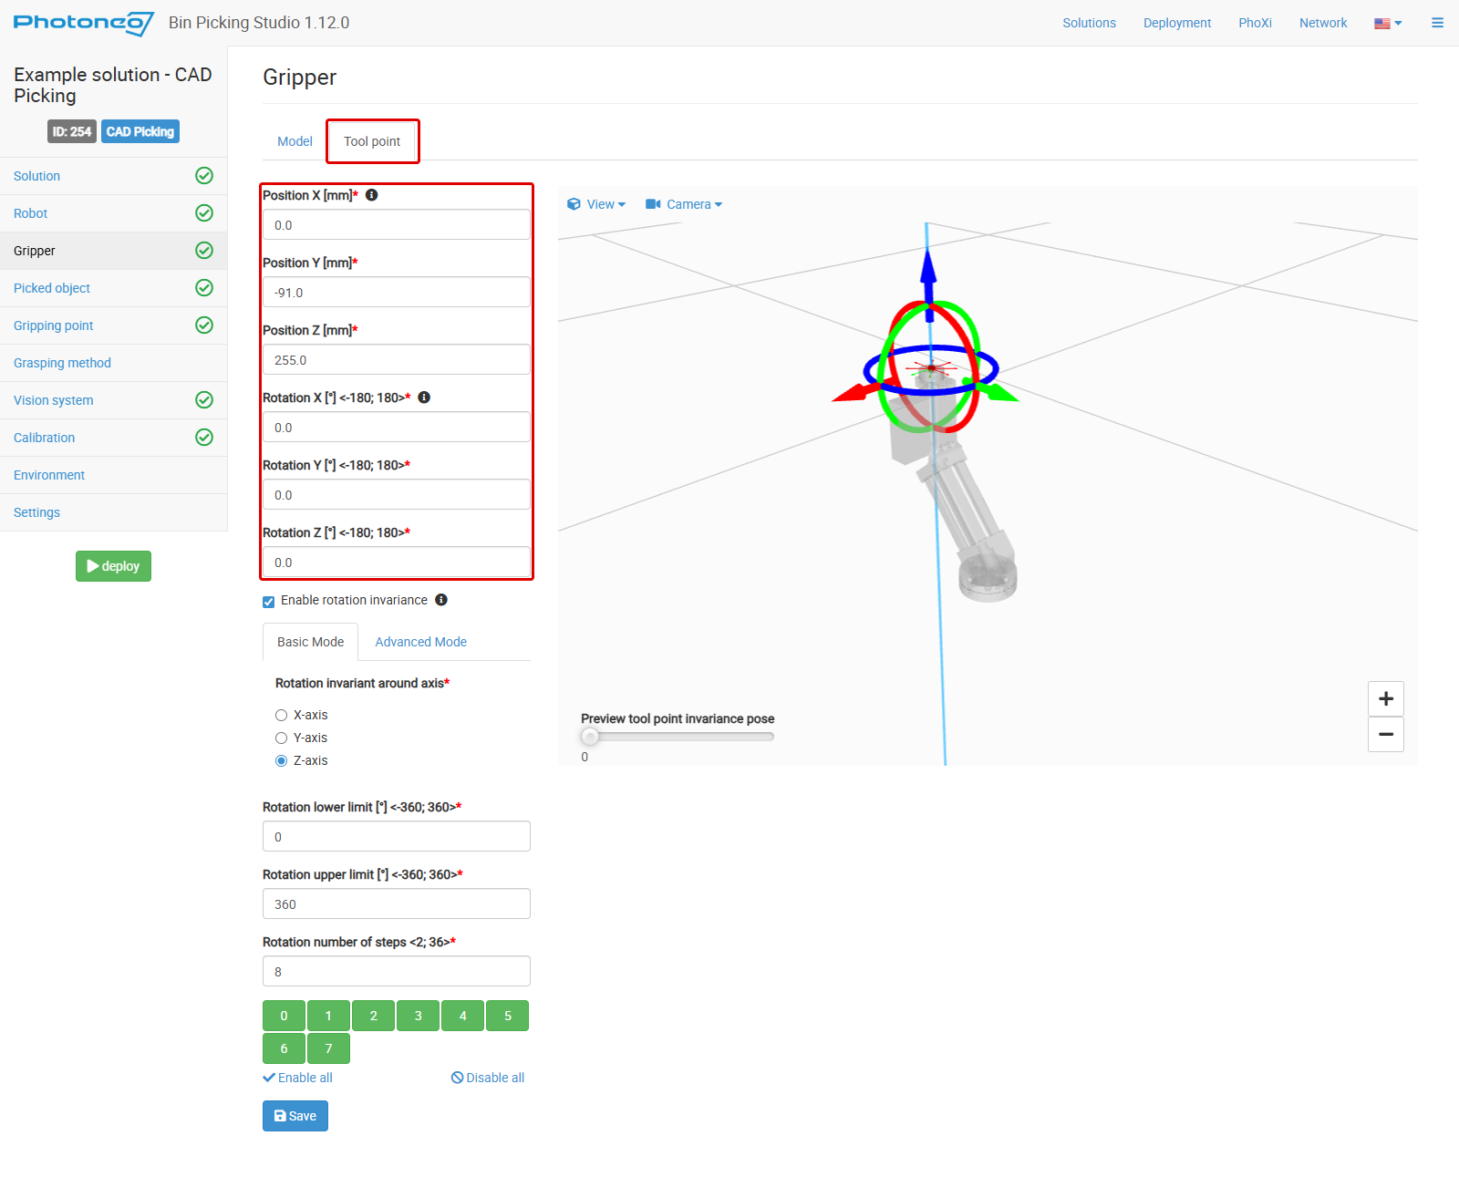
BPS SOLUTION SETUP
Tool point
The point on the gripper that meets a gripping point of the object.
BPS uses its own tool point, not the TCP set on the robot controller.
Defined relative to the origin of the gripper model. The Z-axis points out of the gripper.
Enable rotation invariance: axis, lower and upper limit, and 2–36 steps. Preview the poses with the slider.
Bin Picking Studio 1.12 · Training
33
Notes:
Source in the docs: Gripper > Tool point, Gripping points > Tool point.

Slide 34
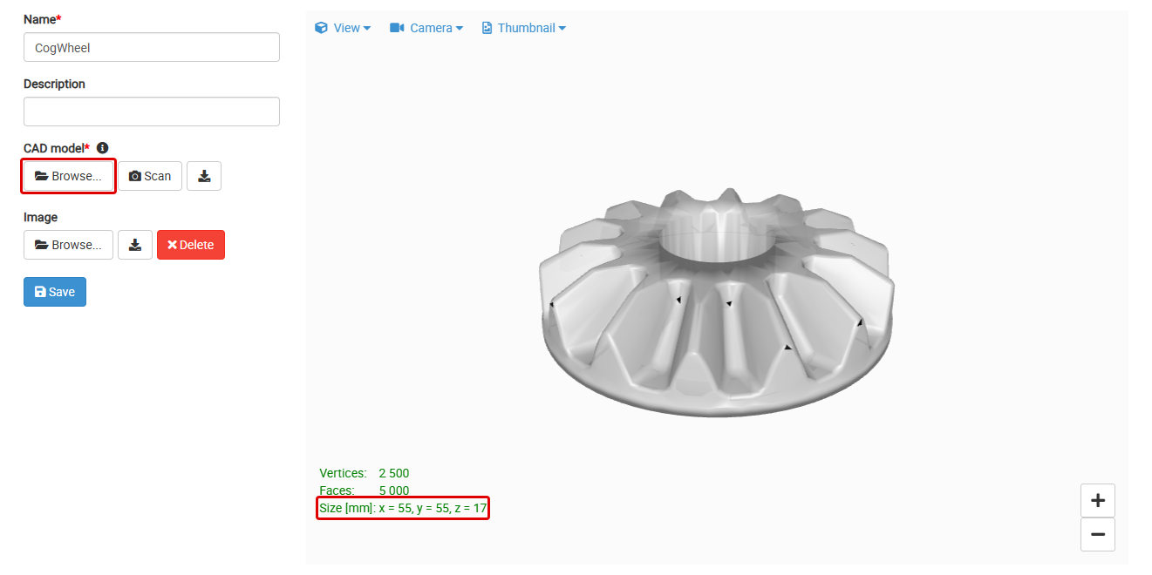
BPS SOLUTION SETUP
Picked object
CAD Picking (and CAD Localization). AI types have no Picked object step.
CAD model: STL or PLY in mm. Browse... uploads a file; Scan takes the model from a connected sensor.
Check before you upload:
units in millimeters (check Size [mm])
no holes, broken faces or extra parts
normals point outward
origin inside or on the object
The Mesh tools tab: cropping, simplification, filtering, normals and origin.
Give the object a clear description of its model or version.
Tip: Use a CAD file for small rigid parts in random orientation. Use a scan + mesh tools for big, semi-oriented parts always seen from one side.
Bin Picking Studio 1.12 · Training
34
Notes:
Source in the docs: Picked object, CAD file, Localization inputs, Mesh tools.

Slide 35
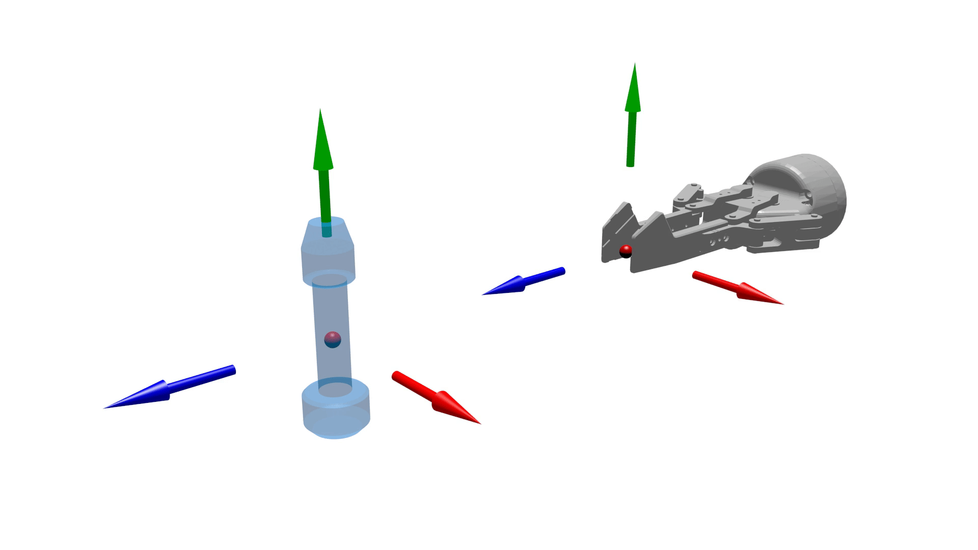
BPS SOLUTION SETUP
Tool point meets gripping point
Tool point: a point on the gripper (Gripper step). One per gripper.
Gripping point: a point on the object where it may be grasped, relative to the origin of the object model. Any number per object.
During the grasp, the two coordinate systems are laid on top of each other.
The gripping point's Z-axis points into the object.
In AI Picking, the Studio places the gripping points itself.
Bin Picking Studio 1.12 · Training
35
Notes:
Source in the docs: Gripping points > Tool point and gripping point.

Slide 36
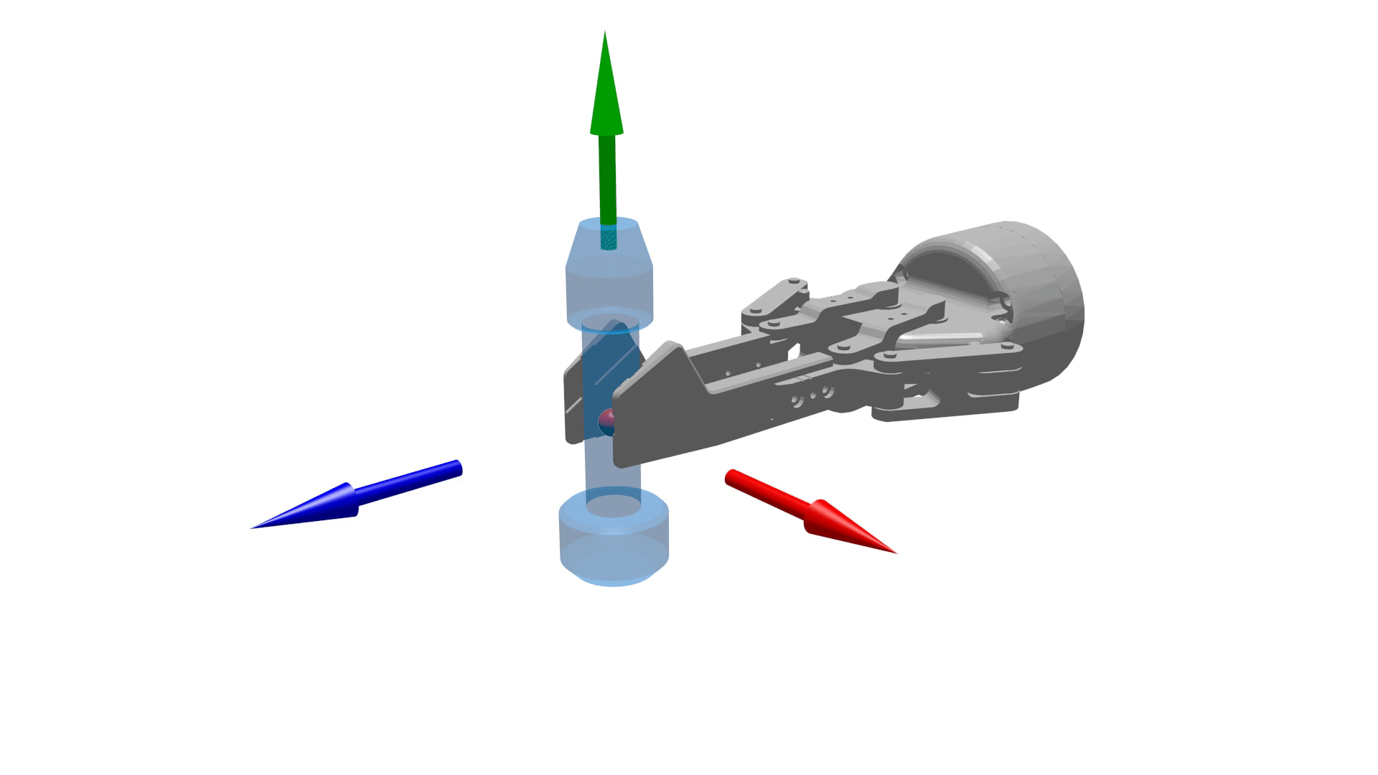
BPS SOLUTION SETUP
Invariances
An invariance is a turn around an axis after which the grasp is the same. It gives the robot more ways to grasp, without more gripping points.
Object (green): a cylinder grasped from the side is the same at any angle.
Two-finger gripper (blue): the same at 0° and 180°.
Tool point and gripping point invariances multiply: 8 × 2 = 16 grasps.
Avoid the same axis on both: a suction cup over a gear gives 8 × 8 = 64 combinations, mostly the same grasp. It slows down picking.
Bin Picking Studio 1.12 · Training
36
Notes:
Source in the docs: Gripping points > Invariance, Multiplying invariances.

Slide 37
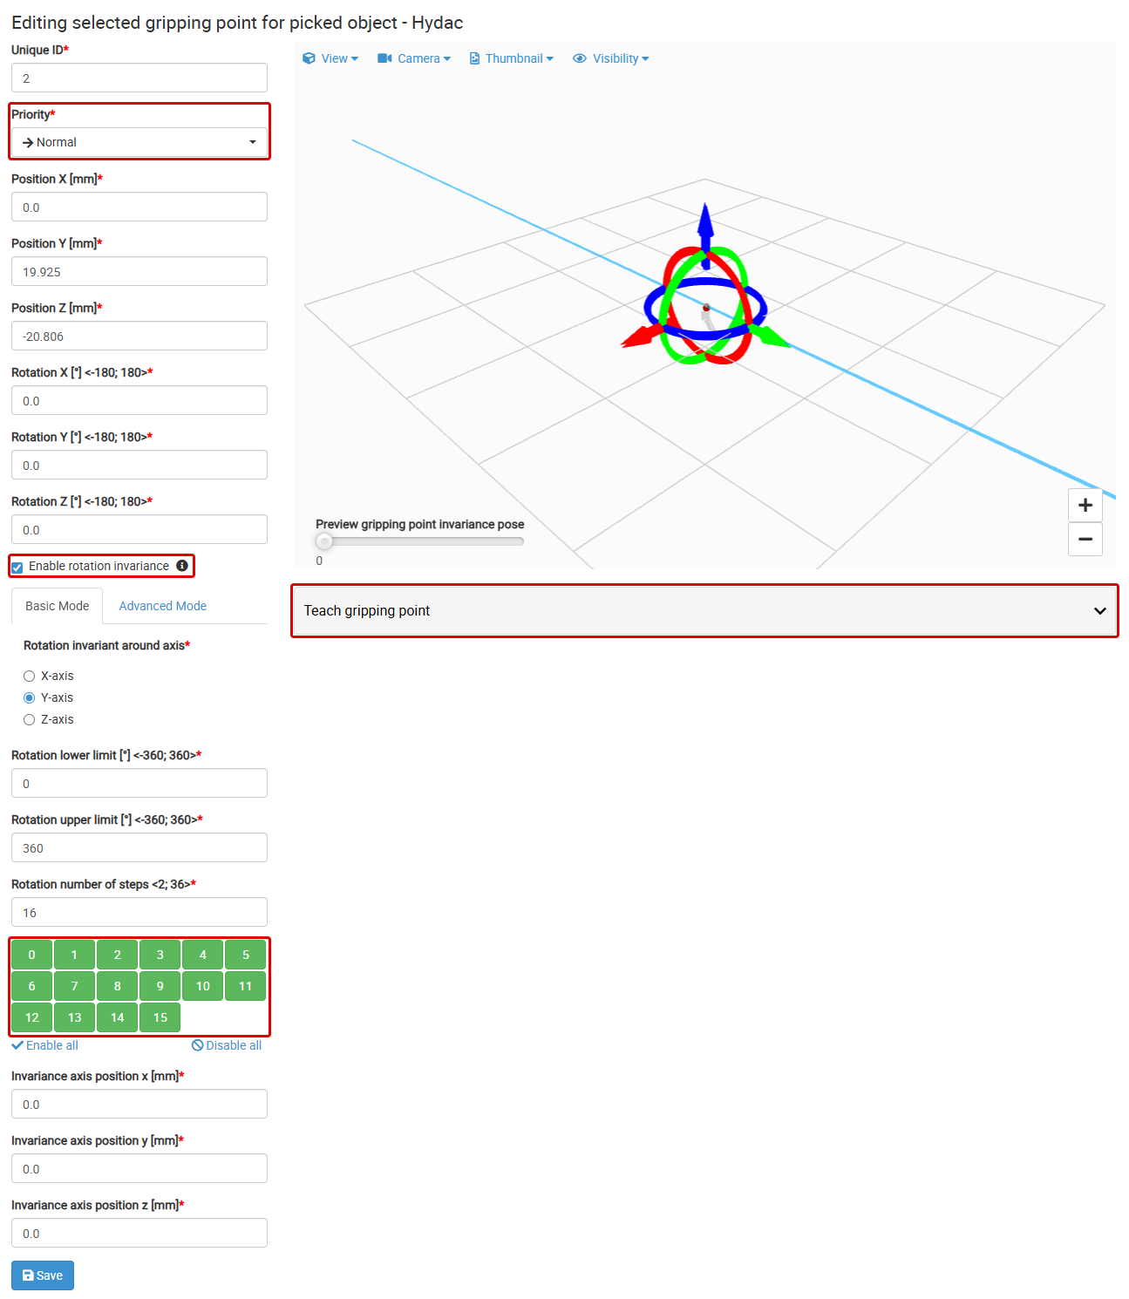
BPS SOLUTION SETUP
Gripping point step
Select the Picked object and click Add new gripping point.
Set the position and rotation, or drag the marker in the 3D viewer.
Optional: Enable rotation invariance and disable steps the gripper cannot use.
Click Save.
Priority (Low / Normal / High) is used when the picking priority method is Gripping Point Priority.
Disable a gripping point to test without it.
Bin Picking Studio 1.12 · Training
37
Notes:
Source in the docs: Gripping points > Gripping point list, form, Rotation invariance.

Slide 38
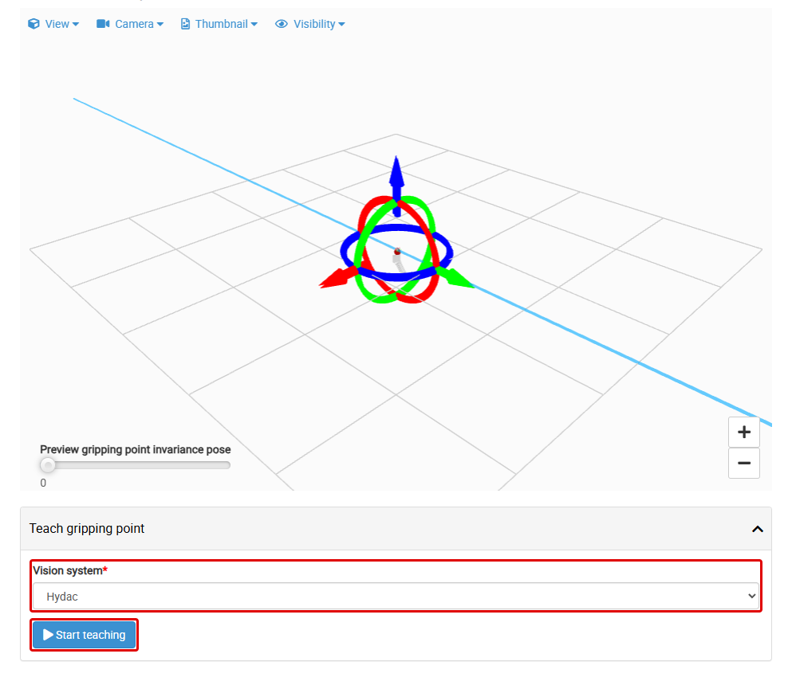
BPS SOLUTION SETUP
Teaching a gripping point
Open the gripping point and the Teach gripping point panel. Select the vision system and click Start teaching.
Place one object in view and scan.
Move the robot with the teach pendant until the gripper grasps the object the way you want.
Reload the robot pose and click the first row of the table (the closest object).
Finish teaching, check the result and Save.
Needs a localization profile, a calibration, a sensor not on the robot arm, a running Robot State Server and a correct tool point.
Bin Picking Studio 1.12 · Training
38
Notes:
Source in the docs: Gripping points > Teaching a gripping point.

Slide 39
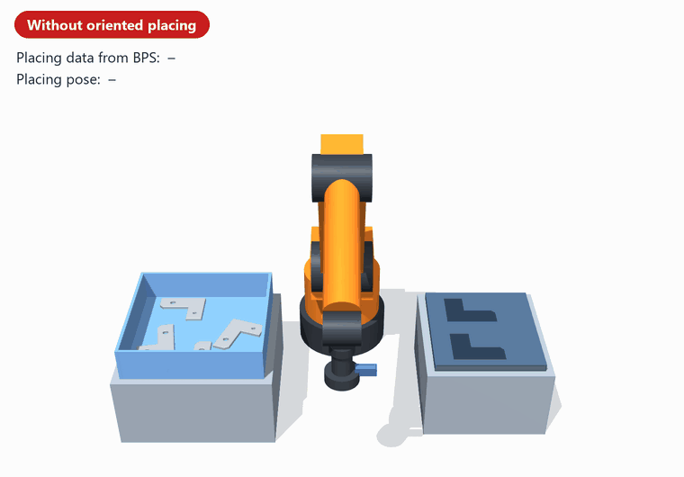
BPS SOLUTION SETUP
Oriented placing
With each trajectory the robot receives the placing data:
tool point invariance
gripping point ID
gripping point invariance
Example: 2 tool point invariances × 3 gripping points × 4 invariances = 24 grasping configurations.
Teach only a few base placing positions and compute the rest from the placing data.
To teach one configuration, temporarily disable the other gripping points and invariances.
Bin Picking Studio 1.12 · Training
39
Notes:
Source in the docs: Gripping points > Oriented placing.

Slide 40
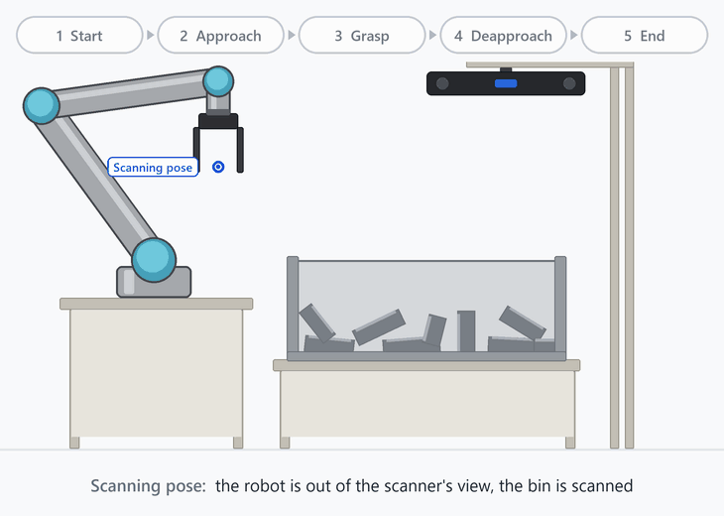
BPS SOLUTION SETUP
Grasping methods
A grasping method is how the robot picks one object: the waypoints, the moves between them and the robot procedures.
Path stage: a waypoint, the move to it and an optional procedure.
Bin picking routine: all path stages, from Start to End.
A new solution has the Basic Grasping Method. Add or duplicate methods when vision systems need different paths.
A vision system uses the current default or one named method.
Bin Picking Studio 1.12 · Training
40
Notes:
Source in the docs: Grasping methods.

Slide 41
BPS SOLUTION SETUP
The five mandatory path stages
Stage | What happens | Pose comes from
1 Start | Prepares the robot and gripper for a new pick | The robot program (Initialization request)
2 Approach | Gripper moves to an offset from the found gripping point, usually a few cm back along its Z-axis | Offset from the found gripping point or the robot base
3 Grasp | Gripper moves to the found gripping point; the procedure closes the gripper (e.g. Attach) | Found gripping point and the tool point
4 Deapproach | Gripper moves away, usually tens of cm up along the robot's Z-axis | An offset (see next slide)
5 End | Gripper moves to the end pose; post-picking operations | The robot program (Initialization request)
You can add custom path stages between them. Drag a custom row to move it.
Moves to Grasp, to Deapproach and to every stage between Approach and Deapproach are always linear.
Bin Picking Studio 1.12 · Training
41
Notes:
Source in the docs: Grasping methods > Path stages, Mandatory and custom path stages.

Slide 42
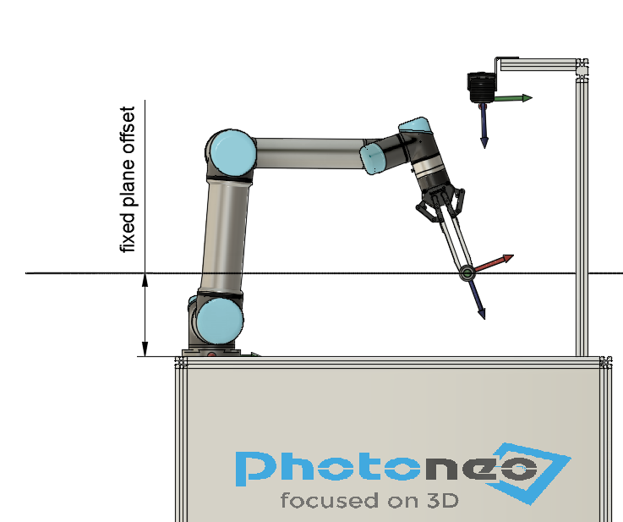
BPS SOLUTION SETUP
Origin of the relative offset
Origin | The waypoint is | For
Found gripping point | Offset in the gripping point's system. Its Z points into the object, so use a negative Z | Approach, Deapproach, custom
Robot | Offset from the previous waypoint in robot base coordinates. +Z is up (floor robot) | Approach, Deapproach, custom
Fixed plane | On a plane parallel to XY, XZ or YZ of the robot base | Deapproach, custom
Start / End | On the way towards the Start or End pose (or a helper point) | Deapproach, custom
Fixed plane: the same height for every part
Tip: Deep bin? Use a Fixed plane Deapproach so every part leaves the bin at the same height. Near the walls? Use Start / End as the origin so the part moves towards the middle of the bin.
Bin Picking Studio 1.12 · Training
42
Notes:
Source in the docs: Grasping methods > Origin of the relative offset.

Slide 43
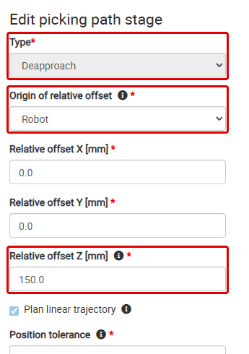
BPS SOLUTION SETUP
Path stage settings
Type: Relative to an origin, or Fixed position in robot space (keeps the previous orientation).
Plan linear trajectory: a straight move. Otherwise the planner may plan a joint move.
Position tolerance:
Precise: the robot reaches the waypoint exactly.
Approximative: the robot blends into the next move. The procedure may run while moving.
Procedure name: Attach, Detach, User 1–3, defined in the robot program.
Bin Picking Studio 1.12 · Training
43
Notes:
Source in the docs: Grasping methods > Editing a path stage.

Slide 44
05
IN THIS CHAPTER
Vision system configuration
Scanning profiles
Vision system and localization
Localization engines
CAD localization and CAD Model Detail
AI and Layer localization
MultiView and bounding boxes

Slide 45
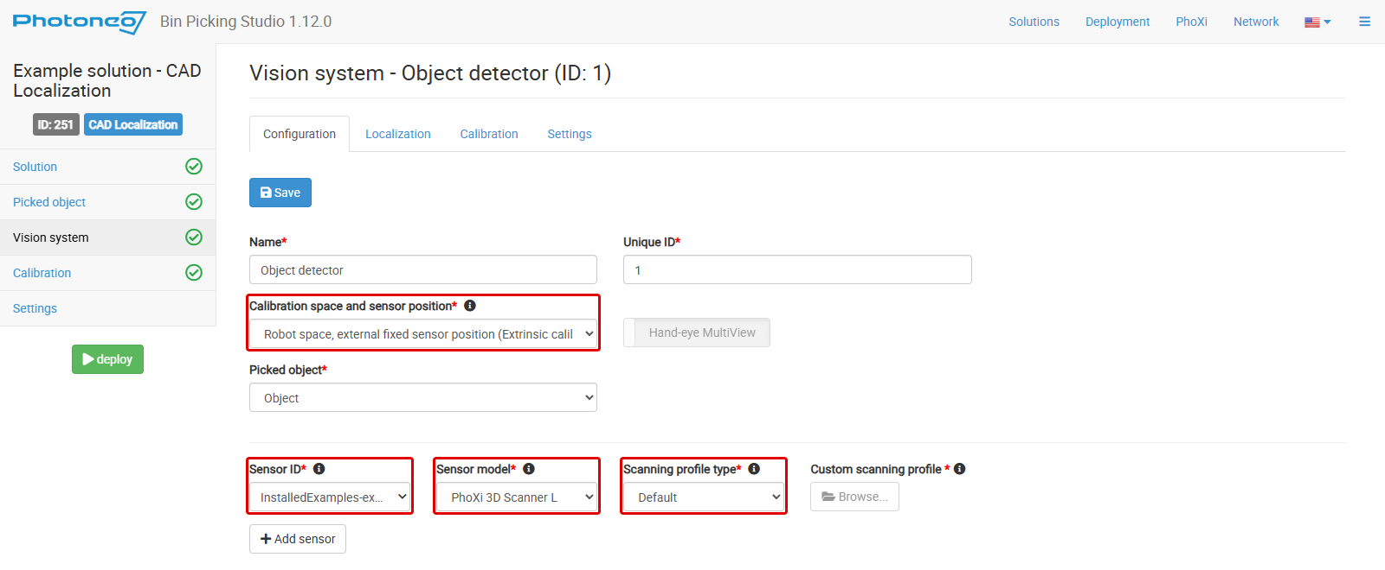
VISION SYSTEM AND LOCALIZATION
Vision system
A vision system ties together the 3D sensor, its calibration, the picked object, the grasping method, the localization profile and its own settings.
Calibration space and sensor position: extrinsic (fixed sensor), hand-eye (sensor on the flange) or marker space (LS only).
Sensors: PhoXi 3D Scanner, MotionCam-3D (Color), Alpha 3D Scanner. Check the Sensor model: it is a collision object.
One sensor can serve several vision systems. MultiView uses several sensors in one.
The robot's requests refer to the vision system ID.
Bin Picking Studio 1.12 · Training
45
Notes:
Source in the docs: 3D sensors and scanning profiles > Vision system configuration.

Slide 46
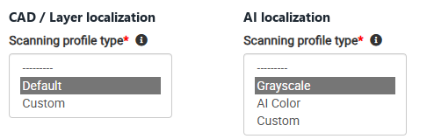
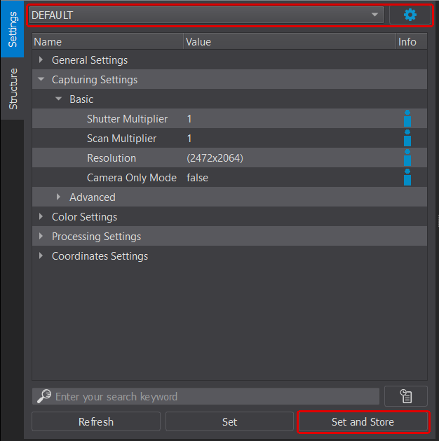
VISION SYSTEM AND LOCALIZATION
Scanning profiles
Default (CAD / Layer) and Grayscale (AI) profiles suit a wide range of objects. AI Color is for sensors with a color camera.
Best results: a Custom profile. Clone a factory profile in PhoXi Control, tune it, Set and Store, export the .phop file and upload it to the vision system.
Calibration uses a built-in profile. In hard conditions, turn on Use custom scanning profile for calibration.
The profile is uploaded to the sensor when a process starts, under its file name:
different profiles on one sensor: use unique names (add the vision system ID)
the same profile: use the same file name to skip switching
The profile "Default" in PhoXi Control is not the Studio's Default.
Bin Picking Studio 1.12 · Training
46
Notes:
Source in the docs: 3D sensors and scanning profiles > Scanning profiles.

Slide 47
VISION SYSTEM AND LOCALIZATION
Localization engines
An engine finds each object and its pose in the point cloud.
Engine | Finds objects by | Solution types | Ideal for
CAD Localization | The 3D (CAD) model | CAD Localization, CAD Picking | Belt picking, assembly, bin picking
AI Localization | Neural networks | AI Localization, AI Picking | Simple and complex depalletization
Layer Localization | The top layer of a stack | Layer Localization (LS only) | Picking whole layers
Hybrid CAD + AI | CAD model and neural networks | On demand only | The most complicated cases
Auxiliary features
CAD Model Detail: model features and feature alignment for nearly symmetrical objects.
MultiView: merges scans from several viewpoints before CAD localization.
Bounding boxes: limit the localization to regions of interest.
Bin Picking Studio 1.12 · Training
47
Notes:
Source in the docs: Localization engines.

Slide 48
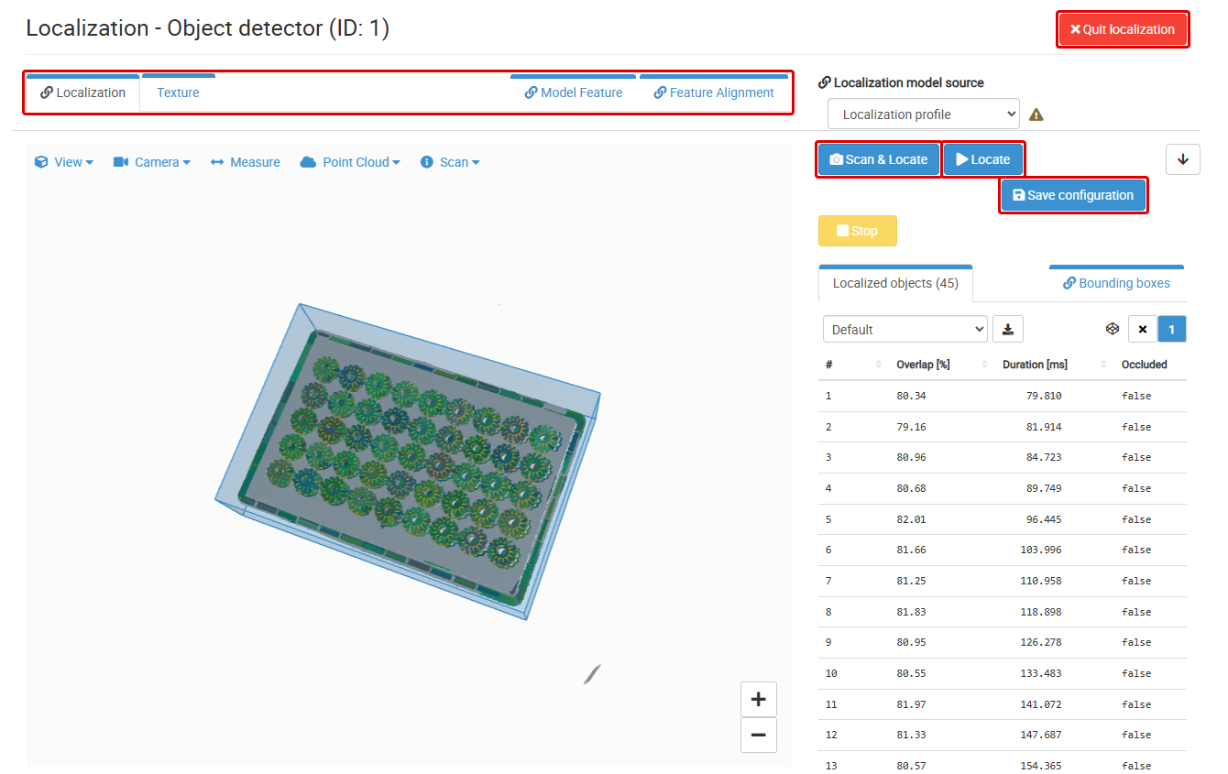
VISION SYSTEM AND LOCALIZATION
CAD localization
Segmentation: the scene is split into segments; too small and too large ones are left out.
Searching: model points are matched to scene points; each match is a candidate.
Fine alignment: candidates are refined with ICP.
Checks: enough Overlap, occlusion and model feature checks.
Stops on a stop criterion: time limit, number of objects, or time without a new object.
The profile (.plcf) holds the model and all settings. Nothing is saved until Save configuration.
Scan & Locate takes a new scan; Locate tests changed settings on the same scan.
Bin Picking Studio 1.12 · Training
48
Notes:
Source in the docs: CAD Localization.

Slide 49
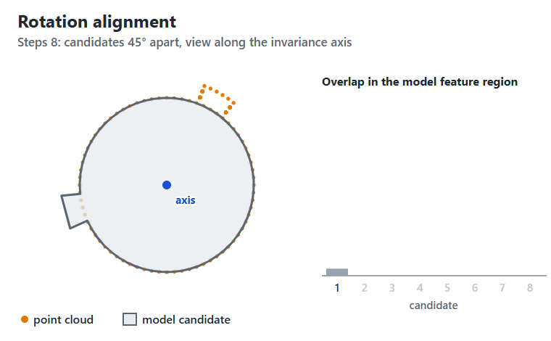
VISION SYSTEM AND LOCALIZATION
CAD Model Detail
For objects that are almost symmetrical, where a small detail decides the pose.
Model feature: mark the detail on the model with a region of interest.
Feature alignment: tell the engine how the object can be wrongly turned (Rotation, Flip and Rotation) or shifted (Translation). It tries those poses and keeps the best match.
The feature must be clearly visible in the scan.
Optional: try tuning the localization first.
Bin Picking Studio 1.12 · Training
49
Notes:
Source in the docs: CAD Model Detail.

Slide 50
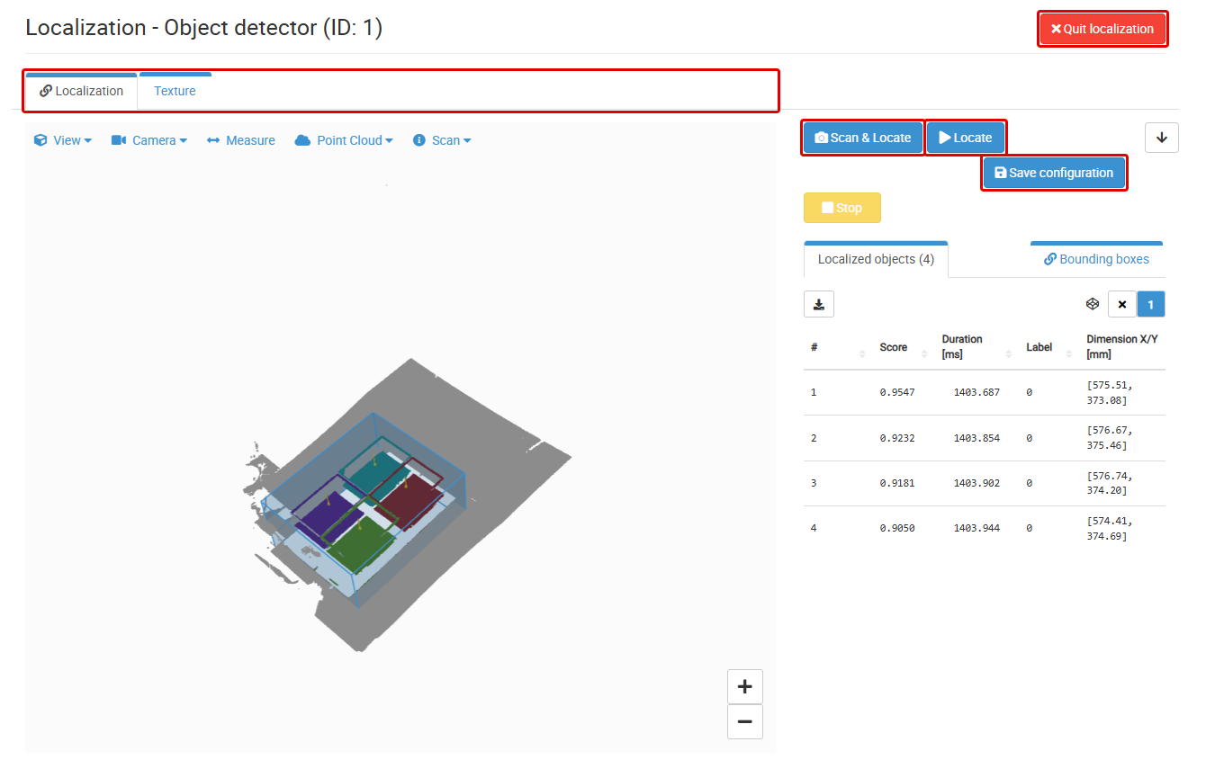
VISION SYSTEM AND LOCALIZATION
AI localization
A neural network finds the objects. No 3D model, so no Picked object step.
Networks: AnyPick modules for boxes, totes, slipsheets, or custom (retrained for your objects).
The profile is a .pacf file, edited like the CAD profile.
Initial gripping point placement method:
dedicated: *Center of Box*, *Center of Tote*
general: *Centroid*, *Largest Inscribed Circle*, *Keypoint from NN*
Reports the X/Y dimensions and the angle of each object.
Bin Picking Studio 1.12 · Training
50
Notes:
Source in the docs: AI localization, Localization inputs.

Slide 51
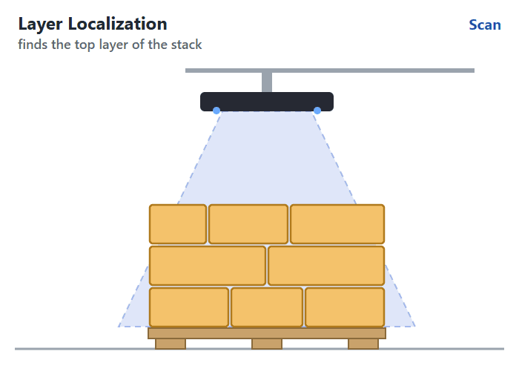
VISION SYSTEM AND LOCALIZATION
Layer localization (LS)
Finds the top layer of a stack and reports its pose.
Ideal for picking whole layers.
Steps: Vision system, Calibration, Settings. No Picked object.
Profile: a .pdcf file on the Localization tab.
Layer settings: Constraint – Object dimensions and Constraint – Points above localized layer.
The robot gets the layer with the Get objects request.
Bin Picking Studio 1.12 · Training
51
Notes:
Source in the docs: Layer Localization.

Slide 52
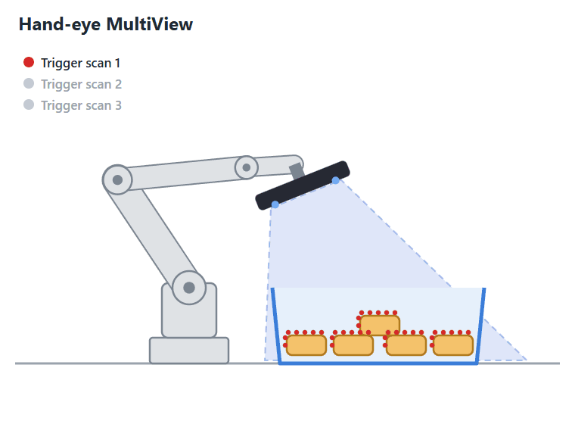
VISION SYSTEM AND LOCALIZATION
MultiView
Merges scans from several viewpoints into one point cloud, so difficult scenes are more complete.
Static MultiView
Several fixed sensors. Calibrate the primary sensor to the robot, then Calibrate together for the others.
Hand-eye MultiView
One sensor on the robot. Static mode: the robot stops for every scan. Dynamic: only for the first (MotionCam-3D in Camera mode).
Robot program: Trigger scan for each view, then Scan to merge and localize.
Bin Picking Studio 1.12 · Training
52
Notes:
Source in the docs: MultiView Localization.

Slide 53
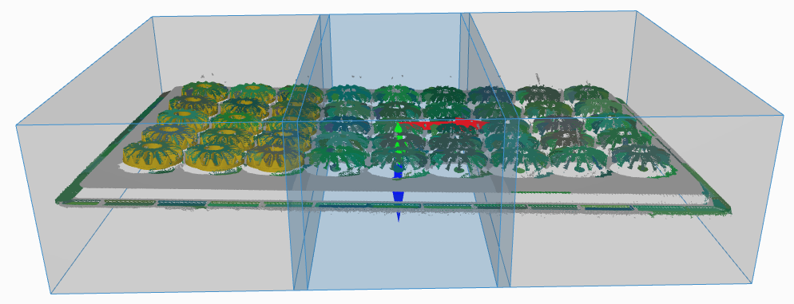
VISION SYSTEM AND LOCALIZATION
Bounding boxes
A region of interest: the engine looks for objects only inside the active box.
Use it for several bins in one scene, to remove false positives, and for speed.
Only one box is active at a time (blue in the viewer). X turns boxes off.
The box with the Initial flag is active after deployment.
The robot switches boxes with Change localization bounding box, sent before the Scan request.
Export and import as .pbbcf files.
Bin Picking Studio 1.12 · Training
53
Notes:
Source in the docs: Bounding boxes.

Slide 54
06
IN THIS CHAPTER
What calibration does
Calibration types
Calibration
Before you start
Calibration modes
Calibrating step by step
Verification and tips

Slide 55
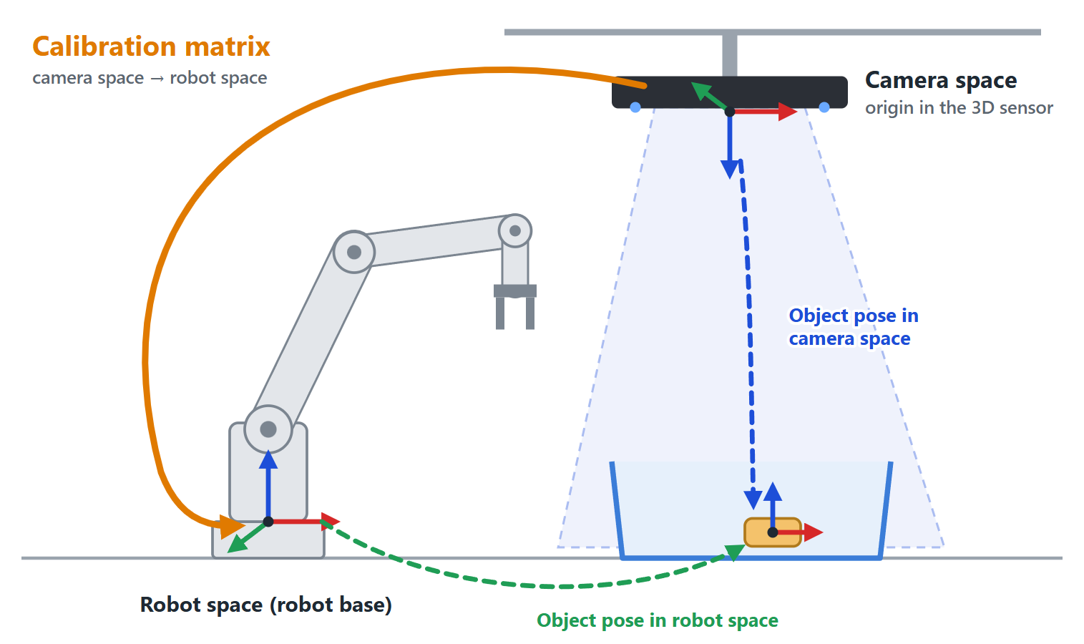
CALIBRATION
What calibration does
The sensor reports poses in camera space; the robot works in robot space.
Calibration finds the calibration matrix between them. The Studio applies it to every localized pose.
Poor calibration is usually the largest source of picking errors.
If the sensor, its mount or the robot moves, calibrate again.
Bin Picking Studio 1.12 · Training
55
Notes:
Source in the docs: Calibration > What calibration does.

Slide 56
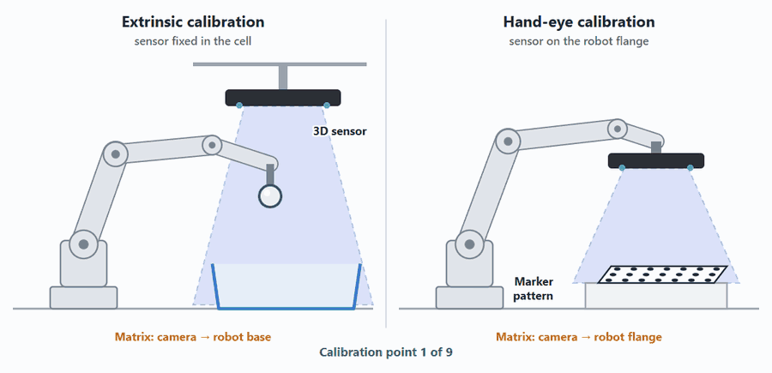
CALIBRATION
Calibration types
Type | Sensor | Tool | Good to know
Extrinsic | Fixed, usually above the bin | Ball on the flange or gripper | Robot may move while the sensor scans
Hand-eye | On the robot, behind the last joint | Marker pattern | Needs the TCP for every scan; robot stands still
Marker space (LS) | Usually fixed | Marker pattern | One scan; then a user frame at the marker origin
Multi-sensor | Several fixed sensors | Marker pattern | Secondary sensors to the primary (Static MultiView)
The type follows from Calibration space and sensor position in the vision system.
Both tools, the calibration ball and the calibration board, come with the package.
Bin Picking Studio 1.12 · Training
56
Notes:
Source in the docs: Calibration > Calibration types.

Slide 57
CALIBRATION
Before you start
Network: the vision controller reaches the sensor and the robot.
Vision system: Sensor ID and calibration space set.
Ball: firmly mounted, mostly visible, round, smooth, not shiny. Larger is better.
Marker pattern: in reach and in view, perfectly flat, must not move.
Base frame offset set (Fanuc, Kawasaki, Stäubli, Yaskawa).
Do not change the tool during calibration.
Robot State Server running (BPS). Without it you can still calibrate manually and type in the TCP.
Tool to select | Extrinsic | Hand-eye
BPS calibration | Any tool | tool0
BPS localization | Does not matter | Does not matter; RSS must run
LS calibration | Any tool | Any tool
LS localization | Does not matter | Same tool as in calibration; send its TCP in Scan
Bin Picking Studio 1.12 · Training
57
Notes:
Source in the docs: Calibration > Before you start, Robot setup.

Slide 58
CALIBRATION
Calibration modes
Mode | Start and save | Add calibration points | Robot pose comes from
Manual | Operator, in the Studio | Operator: Add calibration point | BPS: Robot State Server or typed in. LS: typed in
Semi-automatic | Operator, in the Studio | Robot program: Add calibration point request | BPS: Robot State Server. LS: the request
Automatic | Robot program: Start / Save / Stop requests | Robot program | BPS: Robot State Server. LS: the request
The Robot module has a template program for semi-automatic calibration. Teach your own poses in it. The automatic requests are already there, commented out.
Automatic calibration repeats an operator calibration with the same poses. It needs at least 9 points and the Minimal allowed accuracy.
Simulated calibration (Environment > Vision > Edit) is for testing without a robot. Such a solution cannot run in Production mode.
Bin Picking Studio 1.12 · Training
58
Notes:
Source in the docs: Calibration > Calibration modes, Automatic calibration, Simulated calibration.

Slide 59
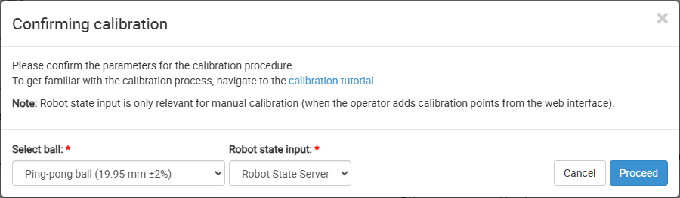
CALIBRATION
Calibrating step by step
Open the Calibration step, check the sensor status and click Start calibration.
Confirm the ball (extrinsic) and the Robot state input (Robot State Server or Operator).
Move the robot to a pose and Add calibration point. A found ball is green on the Texture tab.
Repeat until 9 points, with poses as different as possible.
Check the Calibration accuracy. Replace bad points and points shown as *N/A*.
Verify, then Finish and save result.
Bin Picking Studio 1.12 · Training
59
Notes:
Source in the docs: Calibration > Calibrate a vision system.

Slide 60
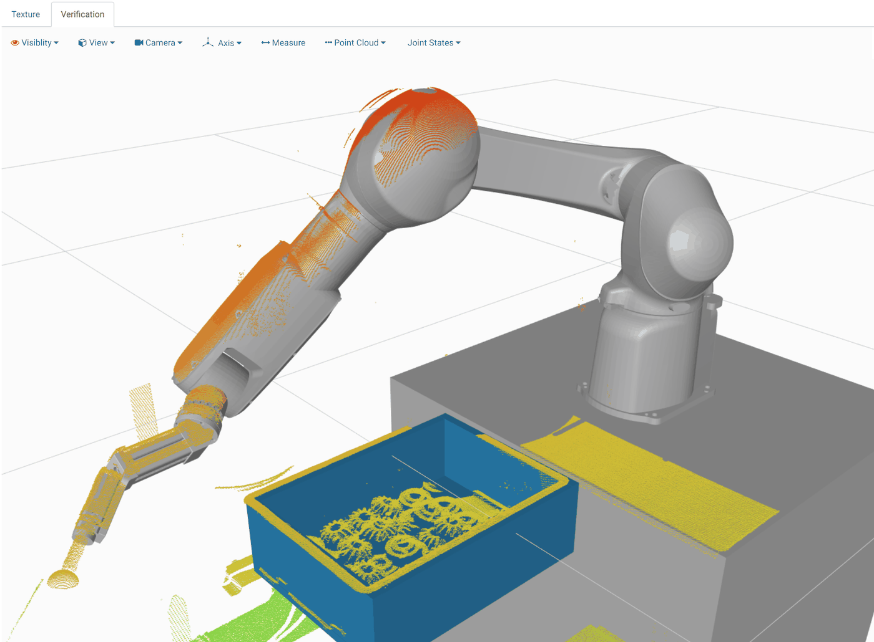
CALIBRATION
Verify the result
From the 4th point (extrinsic) or the 6th (hand-eye), the Verification tab shows the point cloud with the robot model.
Move the robot into view and Trigger scan. A good calibration: the cloud lies on the robot model.
Accuracy is in mm, lower is better. A few mm can still be fine.
Tips
Large joint differences between poses; cover the whole bin.
Cloud shifted along Z? Check the base frame offset.
Ball visible but not found? It may be outside the scanning volume.
Bin Picking Studio 1.12 · Training
60
Notes:
Source in the docs: Calibration > Verify the result, Tips and troubleshooting.

Slide 61
07
IN THIS CHAPTER
Scene: the collision model of the cell
Robot tab: virtual robot and joint limits
Environment
Robot working space
Vision tab: check the scene with a scan
Scene states

Slide 62
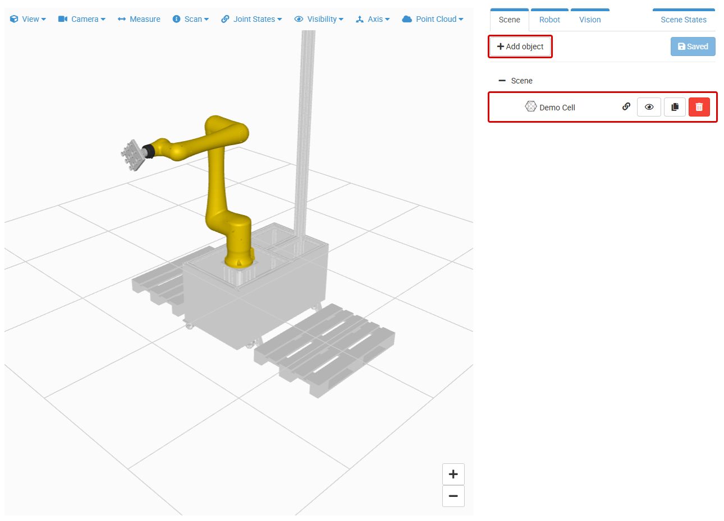
ENVIRONMENT
Scene
The sensor never sees the whole cell. Everything in the robot's reach must be in the scene.
Add objects: Upload STL, Box, Sphere, Cylinder or Group. Objects form a tree.
Types: Bin (blue), Environment (grey), Virtual collision object (red, see-through).
Use simple, slightly inflated bodies. Keep CAD models small.
Align the scene origin with the robot base. Click Save scene.
Bin Picking Studio 1.12 · Training
62
Notes:
Source in the docs: Environment > Scene.

Slide 63
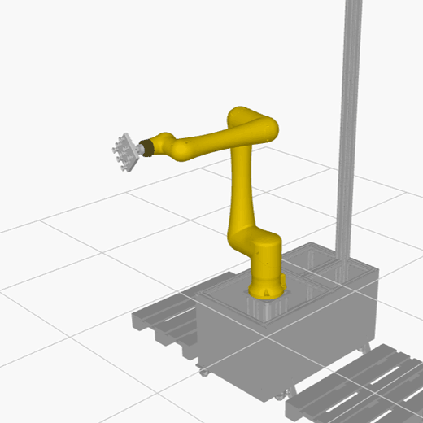
ENVIRONMENT
Robot tab
Move the virtual robot; the real robot does not move.
Motion mode: Joint, Linear (tool), Linear (robot base), or Robot module to show the real robot.
Highlight collisions marks colliding parts.
Messages: Unable to compute inverse kinematics, Robot is in collision.
Works only with a saved scene, a selected robot and a gripper with a tool point.
Bin Picking Studio 1.12 · Training
63
Notes:
Source in the docs: Environment > Robot.

Slide 64


ENVIRONMENT
Joint limits and working space
Joint limits make path planning faster and more successful. Set them.
A limit can only narrow the manufacturer's range. Empty = manufacturer's limit.
Too tight limits make planning fail. Check that the robot reaches every part of the bin.
Generate shows the working space: green = reachable from almost all directions, red = only a few.
Aim for the greener half in and above the bin. (Robots with Rapid IK only.)
Bin Picking Studio 1.12 · Training
64
Notes:
Source in the docs: Environment > Joint limits, Robot working space.

Slide 65

ENVIRONMENT
Vision tab
Lists the vision systems: Calibrated, Uncalibrated or Simulated calibration.
Trigger a scan and move the collision objects until they match the point cloud.
Edit places the sensor by hand (simulated calibration): good for tuning, not for production.
Only one sensor can be connected at a time.
Bin Picking Studio 1.12 · Training
65
Notes:
Source in the docs: Environment > Vision.

Slide 66


ENVIRONMENT
Scene states
When the cell changes during picking, for example a cover opens or a second bin moves in.
An object assigned to a state is in the collision model only while that state is active.
Up to four states. One is Initial: active after deployment.
The robot switches states with Change scene state.
The Active Scene State selector on the Robot tab tests a state.
Scene state 1
Scene state 2
Bin Picking Studio 1.12 · Training
66
Notes:
Source in the docs: Environment > Scene States.

Slide 67
08
IN THIS CHAPTER
How settings are organized
Collision checking
Settings
Path planning
Picking priority and gripper angle
Fast scan and saving scans

Slide 68

SETTINGS
How settings are organized
Global Vision system settings apply to all vision systems unless overridden.
Solution settings apply to the whole solution.
A vision system can override a whole section on its Settings tab. The section on the Settings page then shows the vision system ID.
Changed values are yellow; the reset button restores the default. The info icon shows the help text.
Which sections you see depends on the solution type.
Bin Picking Studio 1.12 · Training
68
Notes:
Source in the docs: Settings.

Slide 69
SETTINGS
Collision checking (BPS)
Setting | What it does | Default
Gripper collision checking type | Volumetric: allows a share of the gripper volume in collision with the scan / objects. Model: no contact at all | Volumetric
Gripper collision sensitivity [%] | Share of the gripper volume allowed in collision. Too low: many rejections. Too high: collisions | 5.0
Collision checking with the picked object attached | The picked object is attached to the gripper from the Deapproach stage on | On
Pick only unoccluded objects | Pick only objects the camera sees fully | Off
Resolution of the point cloud volumetric model [m] | Voxel size of the scene model | 0.01
Minimum required size of a volumetric model segment | Filters small segments, for example reflections | 20
Tip: With the picked object attached, the distance from Grasp to Deapproach must be larger than the biggest dimension of the object.
Bin Picking Studio 1.12 · Training
69
Notes:
Source in the docs: Settings > Gripper / Object / Point cloud collision checking, Deployment > Common collision situations.

Slide 70
SETTINGS
Path planning type
 | Plan joint and linear trajectories | Plan only linear trajectories | Path planning off
Waypoints | Checked for collision | Checked for collision | Checked for collision
Linear trajectories | Checked for collision | Checked for collision | Not planned
Joint trajectories | Checked for collision | Not checked | Not planned
Computation time | Longest | Shorter | Shortest
Use | Default, most cases | Carefully | Carefully
Path planning off: waypoints are sent without trajectories and Plan linear trajectory does not work; the robot moves in joint space.
Also in this section: Path planning timeout [s] (3.0), Path planning attempts (3), Linear trajectory sampling step [m] (0.01) and Prefer linear trajectory (Off).
All can be overridden per vision system.
Bin Picking Studio 1.12 · Training
70
Notes:
Source in the docs: Settings > Path planning (Global Vision system settings).

Slide 71

SETTINGS
Picking priority and gripper angle
Picking priority
Decides the order in which objects go through path planning.
Methods: closest point or centroid in a direction (default 0, 0, −1: top first), localization score, number of collisions with the gripper, Gripping Point Priority.
Gripper angle
Angular threshold (default 50°) between the tool's Z-axis and the reference vector (default 0, 0, 1).
Grasps above the threshold are rejected: status *Grasping angle rejected*.
Bin Picking Studio 1.12 · Training
71
Notes:
Source in the docs: Settings > Picking priority, Gripper angle.

Slide 72
SETTINGS
Fast scan and saving scans
Fast scan (CAD Picking, CAD Localization)
Captures only the texture. Object poses come from memory; only their presence is checked.
Full scans are still needed regularly: Full scan frequency (default 3).
Start with one fast scan per full scan, then try up to five.
Automatic saving of scans
Saves the last set of scans when something goes wrong, for support and analysis.
On internal issues: On by default.
On path planning failed, no object found, pick failed: Off by default. Turn them on before the problem happens.
Folder size limit: 3 GB; older scans are deleted.
Bin Picking Studio 1.12 · Training
72
Notes:
Source in the docs: Settings > Fast scan, Automatic saving of scans.

Slide 73
09
IN THIS CHAPTER
Deploying a solution
Diagnostics, toolbar, console and cycle timer
Deployment and troubleshooting
Object status
The Inspector
Fixing path planning failures
Asking Photoneo support

Slide 74

DEPLOYMENT AND TROUBLESHOOTING
Deploying a solution
Deploy from the ready flag, from the Deployment shortcut in the solution, or on the Deployment page.
Choose the mode:
Production: the robot program sends the requests.
Simulation: you send the requests from the toolbar; the real robot is not needed. Hand-eye vision systems still need the real robot.
Buttons to stop and restart the deployment.
Bin Picking Studio 1.12 · Training
74
Notes:
Source in the docs: Deployment > Deployment page, Deployment modes.

Slide 75

DEPLOYMENT AND TROUBLESHOOTING
Diagnostics, toolbar and console
Hardware diagnostics
Action Request Client, Robot State Server and one sensor indicator per vision system.
Green CONNECTED, orange WARNING, red DISCONNECTED.
Action request toolbar
Production: Scan only.
Simulation: Initialization, Change scene state, Change localization bounding box, Scan, Trajectory.
Console and cycle timer
Log levels INFO, WARN, ERROR, FATAL.
Cycle time = time between two Scan or Trajectory requests of one vision system. Last 20 cycles; failed requests in red.
Bin Picking Studio 1.12 · Training
75
Notes:
Source in the docs: Deployment > Hardware diagnostics, Action request toolbar, Deployment console, Cycle timer.

Slide 76














DEPLOYMENT AND TROUBLESHOOTING
Object status (BPS)
The color of each localized object shows how far it got in path planning.
Pipeline stages, in order
Failure statuses, in order
New object
No gripping points defined
Object from the previous run
Object occluded from scanner position
Path plan from the previous run is not valid
Grasping angle rejected
Path plan from the previous run is valid
Gripper in collision in grasp pose
All waypoints computed
Waypoint computation failed
Trajectory planned
Trajectory planning failed
Ready to pick
Object being picked
Bin Picking Studio 1.12 · Training
76
Notes:
Source in the docs: Deployment > Object status. An object can be grasped in many ways; the status shows the furthest stage any of them reached.

Slide 77

DEPLOYMENT AND TROUBLESHOOTING
The Inspector
Click a localized object, then Show Inspector.
Always shown: GP ID, GP Inv, TP Inv and ∡Z (angle to the gripper reference vector).
Tabs, depending on the status:
Grasp invariances: the grasp pose, IK result, gripper collision
Waypoints: each waypoint, its status and IK result; the colliding pair is shown in red
Trajectories: plays the planned motion; a failed segment is a black line
Bin Picking Studio 1.12 · Training
77
Notes:
Source in the docs: Deployment > Inspector widget.

Slide 78
DEPLOYMENT AND TROUBLESHOOTING
Fixing path planning failures
Status | First things to check
Grasping angle rejected | Tool point and gripping points; Angular threshold; reference vector for wall / ceiling robots
Gripper in collision in grasp pose | Often a real collision: picked later. Otherwise Gripper collision sensitivity, gripping points, scan quality
Waypoint: Unreachable | Joint limits, a reachable gripping point, bin position, IK solver timeout
Waypoint: In collision | The colliding pair in the Inspector; gripping points and grasping method; scan quality
Cartesian threshold failed | A joint turns more than 0.3 rad between points: set joint limits, lower the sampling step
Linear / joint trajectory is too long | More than 100 points: bring the two waypoints closer, raise the sampling step
End position mismatch | Adjust joint limits so the End waypoint has only the End pose configuration
Bin Picking Studio 1.12 · Training
78
Notes:
Source in the docs: Deployment > Troubleshooting path planning.

Slide 79

DEPLOYMENT AND TROUBLESHOOTING
Common collision situations
Scan ↔ gripper in Approach: Approach is too close to the object; reflections above it collide. Move Approach further away.
Picked object ↔ scan in Deapproach: the Grasp-to-Deapproach distance is smaller than the object. Make it larger.
Picked object ↔ bin wall in Deapproach: lean away from the walls. Use Start / End as the origin, with Start / End above the middle of the bin.
Floating points from reflections: raise Minimum required size of a volumetric model segment.
Bin Picking Studio 1.12 · Training
79
Notes:
Source in the docs: Deployment > Common collision situations, Impact of scan quality on collision checking.

Slide 80
DEPLOYMENT AND TROUBLESHOOTING
Troubleshooting overview
Problem | Where to look
The robot can't connect | Hardware diagnostics; Test connection on the Network page; error codes 3 and 5
The sensor isn't found | Sensor indicator; IP addresses of interface and sensor; PhoXi page
Calibration is inaccurate or fails | Diverse poses, base frame offset, tool, Robot State Server, custom calibration profile
No object found or objects rejected | Error codes 202 / 502–505; bounding box; constraints; scanning profile
Path planning fails or the gripper collides | Object status and Inspector; collision situations; save the scans
Bin Picking Studio 1.12 · Training
80
Notes:
Source in the docs: Deployment > Troubleshooting overview.

Slide 81

DEPLOYMENT AND TROUBLESHOOTING
Asking Photoneo support
Send your request to support@photoneo.com. Describe the problem and attach:
Support logs: menu > Download support logs.
Deployment console logs: menu > Download deployment console logs.
Saved scans of the situation. Turn on Automatic saving of scans before the problem happens.
The solution export (.pbcf).
After a fatal error, the An error occurred dialog offers the support logs and a link to the Photoneo Help Center.
Bin Picking Studio 1.12 · Training
81
Notes:
Source in the docs: Deployment > Support logs.

Slide 82
10
IN THIS CHAPTER
LS solutions
Reported pose and origin offset
Locator Studio specifics
Pose constraints

Slide 83
LOCATOR STUDIO SPECIFICS
Locator Studio solutions
Solution type | Setup steps
CAD Localization | Picked object, Vision system, Calibration, Settings
AI Localization | Vision system, Calibration, Settings
Layer Localization | Vision system, Calibration, Settings
No Robot, Gripper, Grasping method or Environment: the robot program plans the motion.
The robot sends Scan, then gets the poses with Get objects. A timeout applies (Get objects request timeout [s]).
Robot side: the Robot module, or your own Action Request Client on any compatible controller or PLC. The Robot State channel is optional.
Calibration: extrinsic, hand-eye, or marker space (one scan; then define a user frame at the marker origin).
Hand-eye LS: use the same tool as in calibration and send its TCP in the Scan request.
Bin Picking Studio 1.12 · Training
83
Notes:
Source in the docs: LS Solution Setup, Solution types, Calibration.

Slide 84

LOCATOR STUDIO SPECIFICS
Reported pose
By default LS reports the origin of the object model.
Enable model origin offset to report another point: type translation and rotation, drag the marker, or click Automatic (center of the geometry).
Example: origin in the middle of the top face with Z pointing down. The tool point can then move straight to the reported pose.
Constraint – Angle rejects objects whose Z-axis is more than 25° (default) from the vector 0, 0, −1.
Bin Picking Studio 1.12 · Training
84
Notes:
Source in the docs: Reported pose, CAD file > Changing the origin in Locator Studio.

Slide 85
WRAP-UP
Where to find more
Documentation (VGR 1.12)
Getting Started
Studio Interface
Common Setup (BPS & LS)
BPS Solution Setup
LS Solution Setup
Deployment
Robot Module: integration guides, action requests, error codes
Support
support@photoneo.com
Photoneo Help Center: www.photoneo.com/Help-Center
In the Studio
The info icon next to each field shows its help text.
Menu > Documentation
Bin Picking Studio 1.12 · Training
85
Notes:
Point the trainees to the docs pages used in this deck.

Slide 86
Thank you
...and happy picking!
support@photoneo.com

